Slide 1
Database Systems: Theory and Programming MongoDB
“He uses statistics as a drunken man uses lamp posts – for support rather than for illumination."
Andrew Lang Scottish writer
Notes:
Replace this with your course title and your name/contact details.

Slide 2
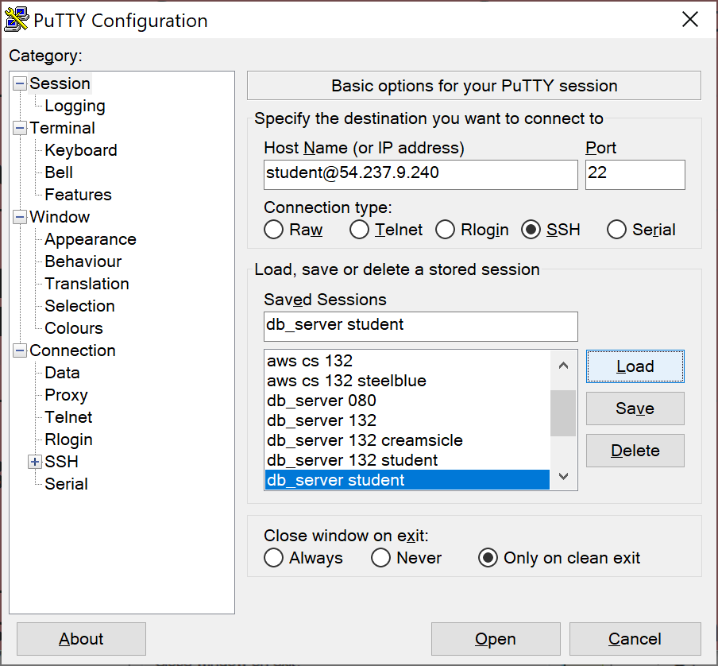
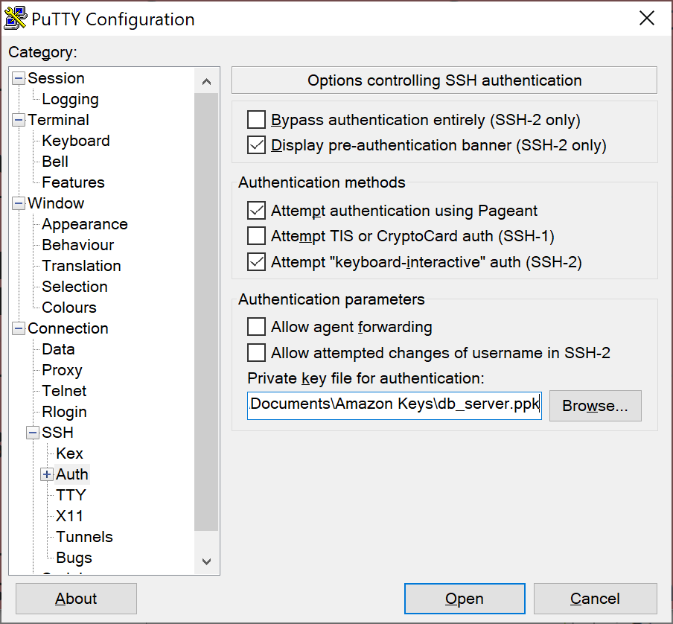

Connecting to the DB Server

Slide 3
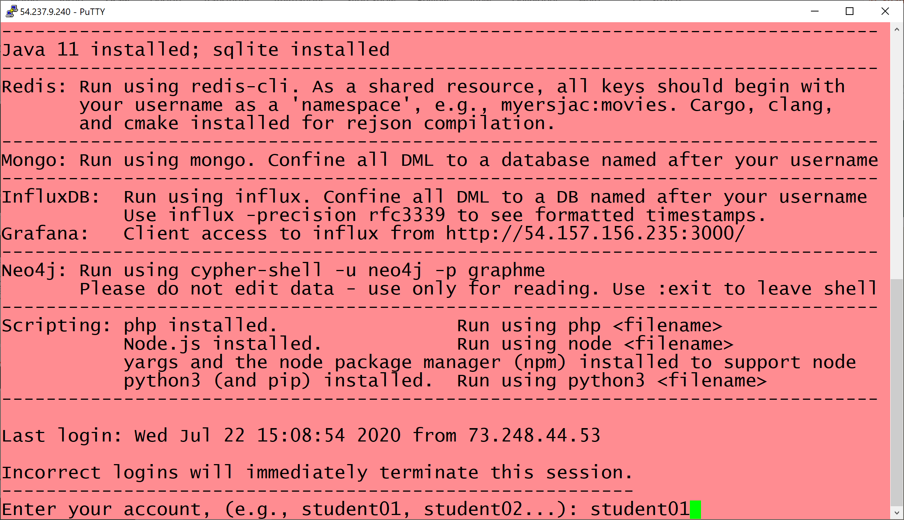
Then enter your student account

Slide 4
Mongo!

Slide 5
What is MongoDB?
MongoDB is an open-source document database, written in C++, and the leading NoSQL database
A document-oriented database replaces the concept of a “row” with a more flexible model, the “document.”
By allowing embedded documents and arrays, the document-oriented approach makes it possible to represent complex hierarchical relationships with a single record.
Documents are stored in BSON (Binary JSON) format rather than pure JSON
Additional data types
More efficient storage

Slide 6
Additional Data Types in BSON
null
Null can be used to represent both a null value and a nonexistent field: { x : null }
boolean
{ x : true }
number
The shell defaults to using 64-bit floating point numbers. Thus, these numbers look “normal” in the shell: { x : 3.14 } or: { x : 3 }
For integers, use the NumberInt or NumberLong classes, which represent 4-byte or 8-byte signed integers, { x : NumberInt("3") } { x : NumberLong("3") }
date
Dates are stored as milliseconds since the epoch. The time zone is not stored: { x : new Date() }
regular expression
Queries can use regular expressions using JavaScript’s regular expression syntax: { x : /foobar/i }
array
Sets or lists of values can be represented as arrays: { things : ["pie", 3.14] }
embedded document
Documents can contain entire documents embedded as values in a parent document: { x : { foo : "bar" } }

Slide 7

Key Terms
Database
Database is a physical container for collections.
Each database gets its own set of files on the file system. A single MongoDB server typically has multiple databases.
Collection
Collection is a group of MongoDB documents. It is the equivalent of an RDBMS table.
A collection exists within a single database. Collections do not enforce a schema.
Documents within a collection can have different fields. Typically, all documents in a collection are of similar or related purpose.
Grouping documents of the same kind together in the same collection allows for data locality.
Getting several blog posts from a collection containing only posts will likely require fewer disk seeks than getting the same posts from a collection containing posts and author data.
RDBMS term | MongoDB construct
Database | Database
Table | Collection
Tuple/row | Document
Column | Field
Table join | Embedded document
Primary key | Primary key (Default key _id provided by mongodb itself)
Foreign key | Reference
Dynamic schema means that
Documents in the same collection do not need to have the same set of fields or structure,
Common fields in a collection's documents may hold different types of data.

Slide 8
Sample Document
{
_id: ObjectId(7df78ad8902c)
title: 'MongoDB Overview',
description: 'MongoDB is a NoSQL database',
by: 'tutorials point',
url: 'http://www.tutorialspoint.com',
tags: ['mongodb', 'database', 'NoSQL'],
likes: 100,
comments: [
{
user:'user1',
message: 'My first comment',
dateCreated: new Date(2016,6,29,12,45),
like: 0
},
{
user:'user2',
message: 'My second comment',
dateCreated: new Date(2016,6,29,12,55),
like: 5
}
]
}
Primary key
_id (always)
Data in key-value pairs
A bit like column and column value in RDBMS, but without the rigidity of constant columns
No concept of relationships
Related information is embedded in the document
In an RDBMS, comments would be stored in a separate relation. Document : Comments & Document : Tags both 1 : N

Slide 9
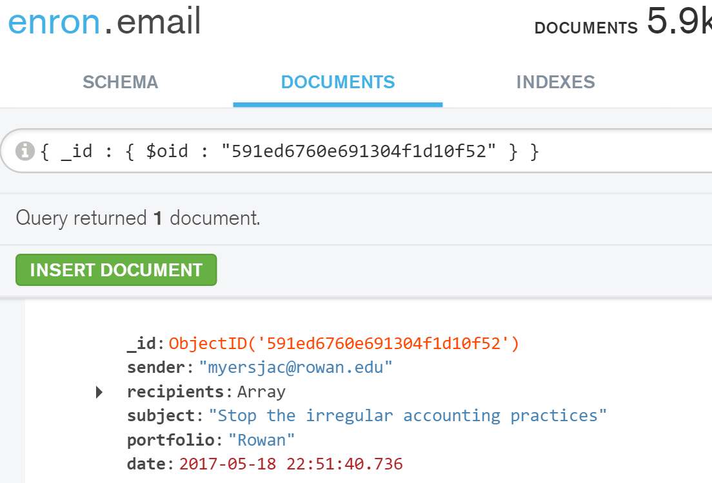
Querying by _id
In Mongo shell (server)
In MongoDB Compass (client)
Note how Compass displays _id as ObjectID with a capital D.
This is confusing, because we know that the Mongo datatype is ObjectId and the Mongo function is ObjectId()

Slide 10
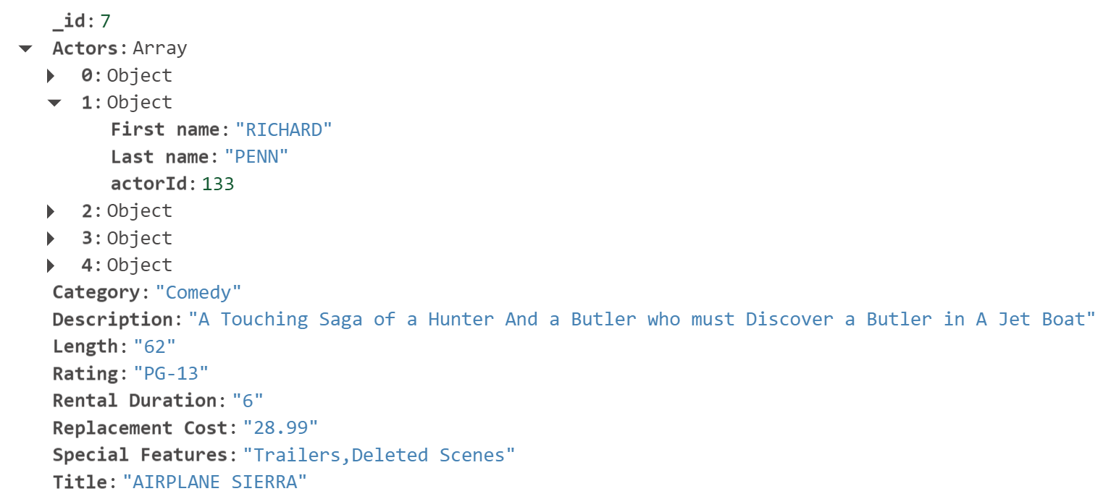
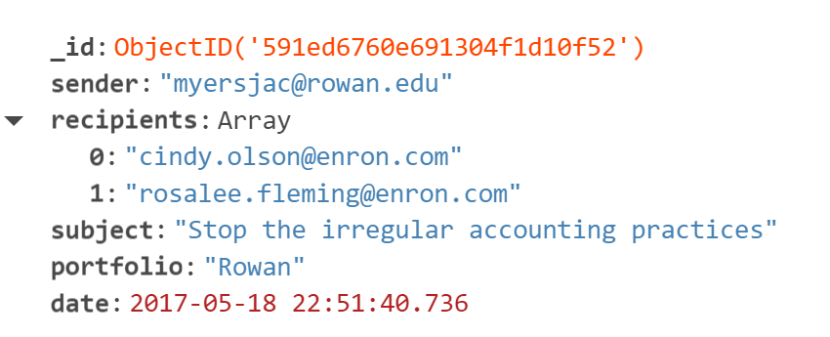
_id Autogenerated or Assigned
_id set to the primary key from sakila.film and is a number
_id autogenerated by server and is of type ObjectId

Slide 11
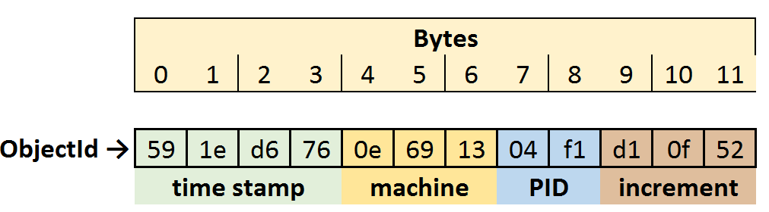
Autogenerated ObjectIds
The 12 bytes of an ObjectId are represented as hexadecimal andgenerated as follows:
Timestamp: seconds elapsed since the epoch. When combined with the next five bytes this provides uniqueness at the granularity of a second. Since timestamp comes first, it means that ObjectIds will sort in roughly insertion order.
MachineIidentifier: usually a hash of the machine’s hostname. By including these bytes, we guarantee that different machines will not generate colliding ObjectIds. To provide uniqueness among different processes generating ObjectIds concurrently on a single machine,
Process identifier (PID) of the ObjectId-generating process to provide uniqueness among different processes generating ObjectIds concurrently on a single machine,
Incrementing counter that is responsible for uniqueness within a second in a single process.

Slide 12
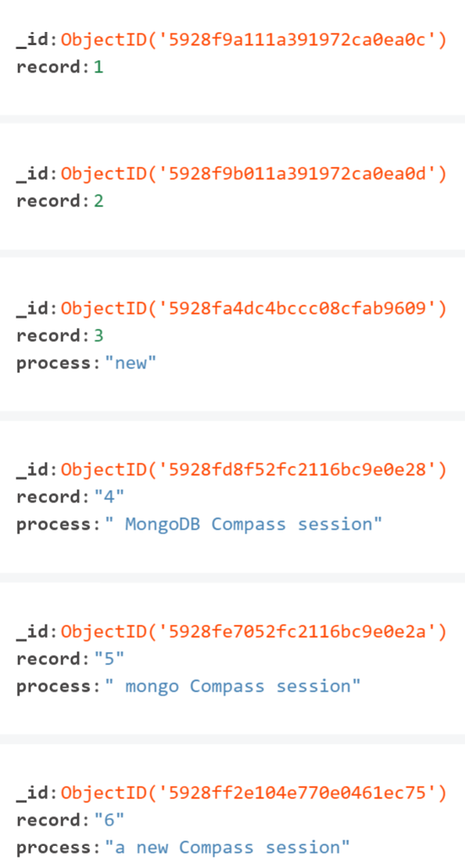
Autogenerated ObjectIds in Practice
timestamp machine PID increment
Records 1 and 2 created in terminal emulation session with Mongo server
Record 3 created in a different terminal emulation session with Mongo server
Records 4 and 5 created in a client MongoDB Compass session
Record 6 created in a different client MongoDB Compass session

Slide 13
Advantages of MongoDB
Advantages of MongoDB over RDBMS
Schema less : MongoDB is document database in which one collection holds different different documents. Number of fields, content and size of the document can be differ from one document to another.
Structure of a single object is clear
No complex joins
Deep query-ability. MongoDB supports dynamic queries on documents using a document-based query language that's nearly as powerful as SQL
Tuning
Ease of scale-out: MongoDB is easy to scale (see next slide)
Conversion / mapping of application objects to database objects not needed
Uses internal memory for storing the (windowed) working set, enabling faster access of data
Why should use MongoDB
Document Oriented Storage: Data is stored in the form of JSON style documents
Index on any attribute
Replication & High Availability
Auto-Sharding (automatice partitioning)
Rich Queries
Where should use MongoDB?
Big Data
Content Management and Delivery
Mobile and Social Infrastructure
User Data Management
Data Hub (collection of data from multiple sources)

Slide 14
Scalability: Up vs Out
How can one scale a database?
Scale up (get a bigger machine)
Scale out (partitioning data across more machines).
MongoDB was designed to scale out.
Its document-oriented data model makes it easier for it to split up data across multiple servers.
MongoDB automatically takes care of balancing data and load across a cluster, redistributing documents automatically and routing user requests to the correct machines.

Slide 15
Starting MongoDB and getting help
Database level help
Collection level help

Slide 16
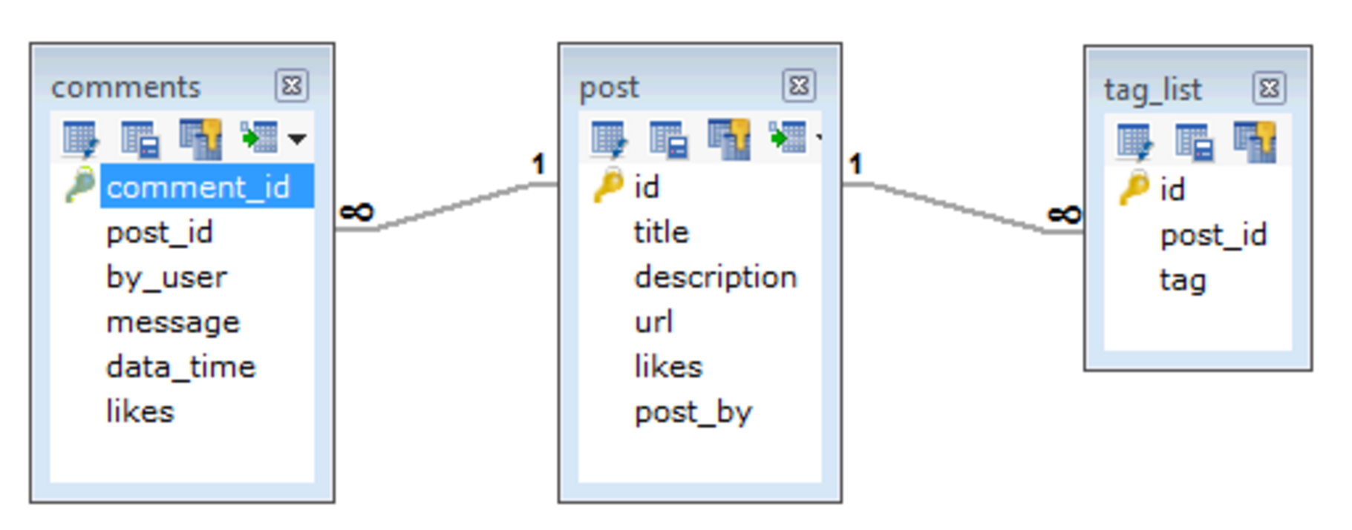
Modeling a Mongo DB
{
_id: ObjectId(7df78ad8902c)
title: 'MongoDB Overview',
description: 'MongoDB is a NoSQL database',
by: 'tutorials point',
url: 'http://www.tutorialspoint.com',
tags: ['mongodb', 'database', 'NoSQL'],
likes: 100,
comments: [
{
user:'user1',
message: 'My first comment',
dateCreated: new Date(2016,6,29,12,45),
like: 0
},
{
user:'user2',
message: 'My second comment',
dateCreated: new Date(2016,6,29,12,55),
like: 5
}
]
}
Tag relation becomes a simple multi- valued value
Comments becomes a multi-valued data structure
Relational model
Two 1:N relationships

Slide 17

Sharding in MongoDB
see page
894
Performance problems can ensue when a collection
Holds a very large number of documents
Requires a large storage space
Sharding is a solution
Also known as horizontal partitioning
Divides the database into partitions known as shards
Allows for horizontal scaling

Slide 18
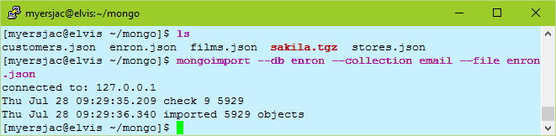
Importing JSON data into Mongo
Mongoimport
--db <name of database>
--collection <name of "table">
--file <name of JSON file>
--jsonArray recognizes an array of json docs
List databases / collections
db.getMongo().getDBNames()
db.getCollectionNames()

Slide 19
MongoDB Syntax: Queries

Slide 20
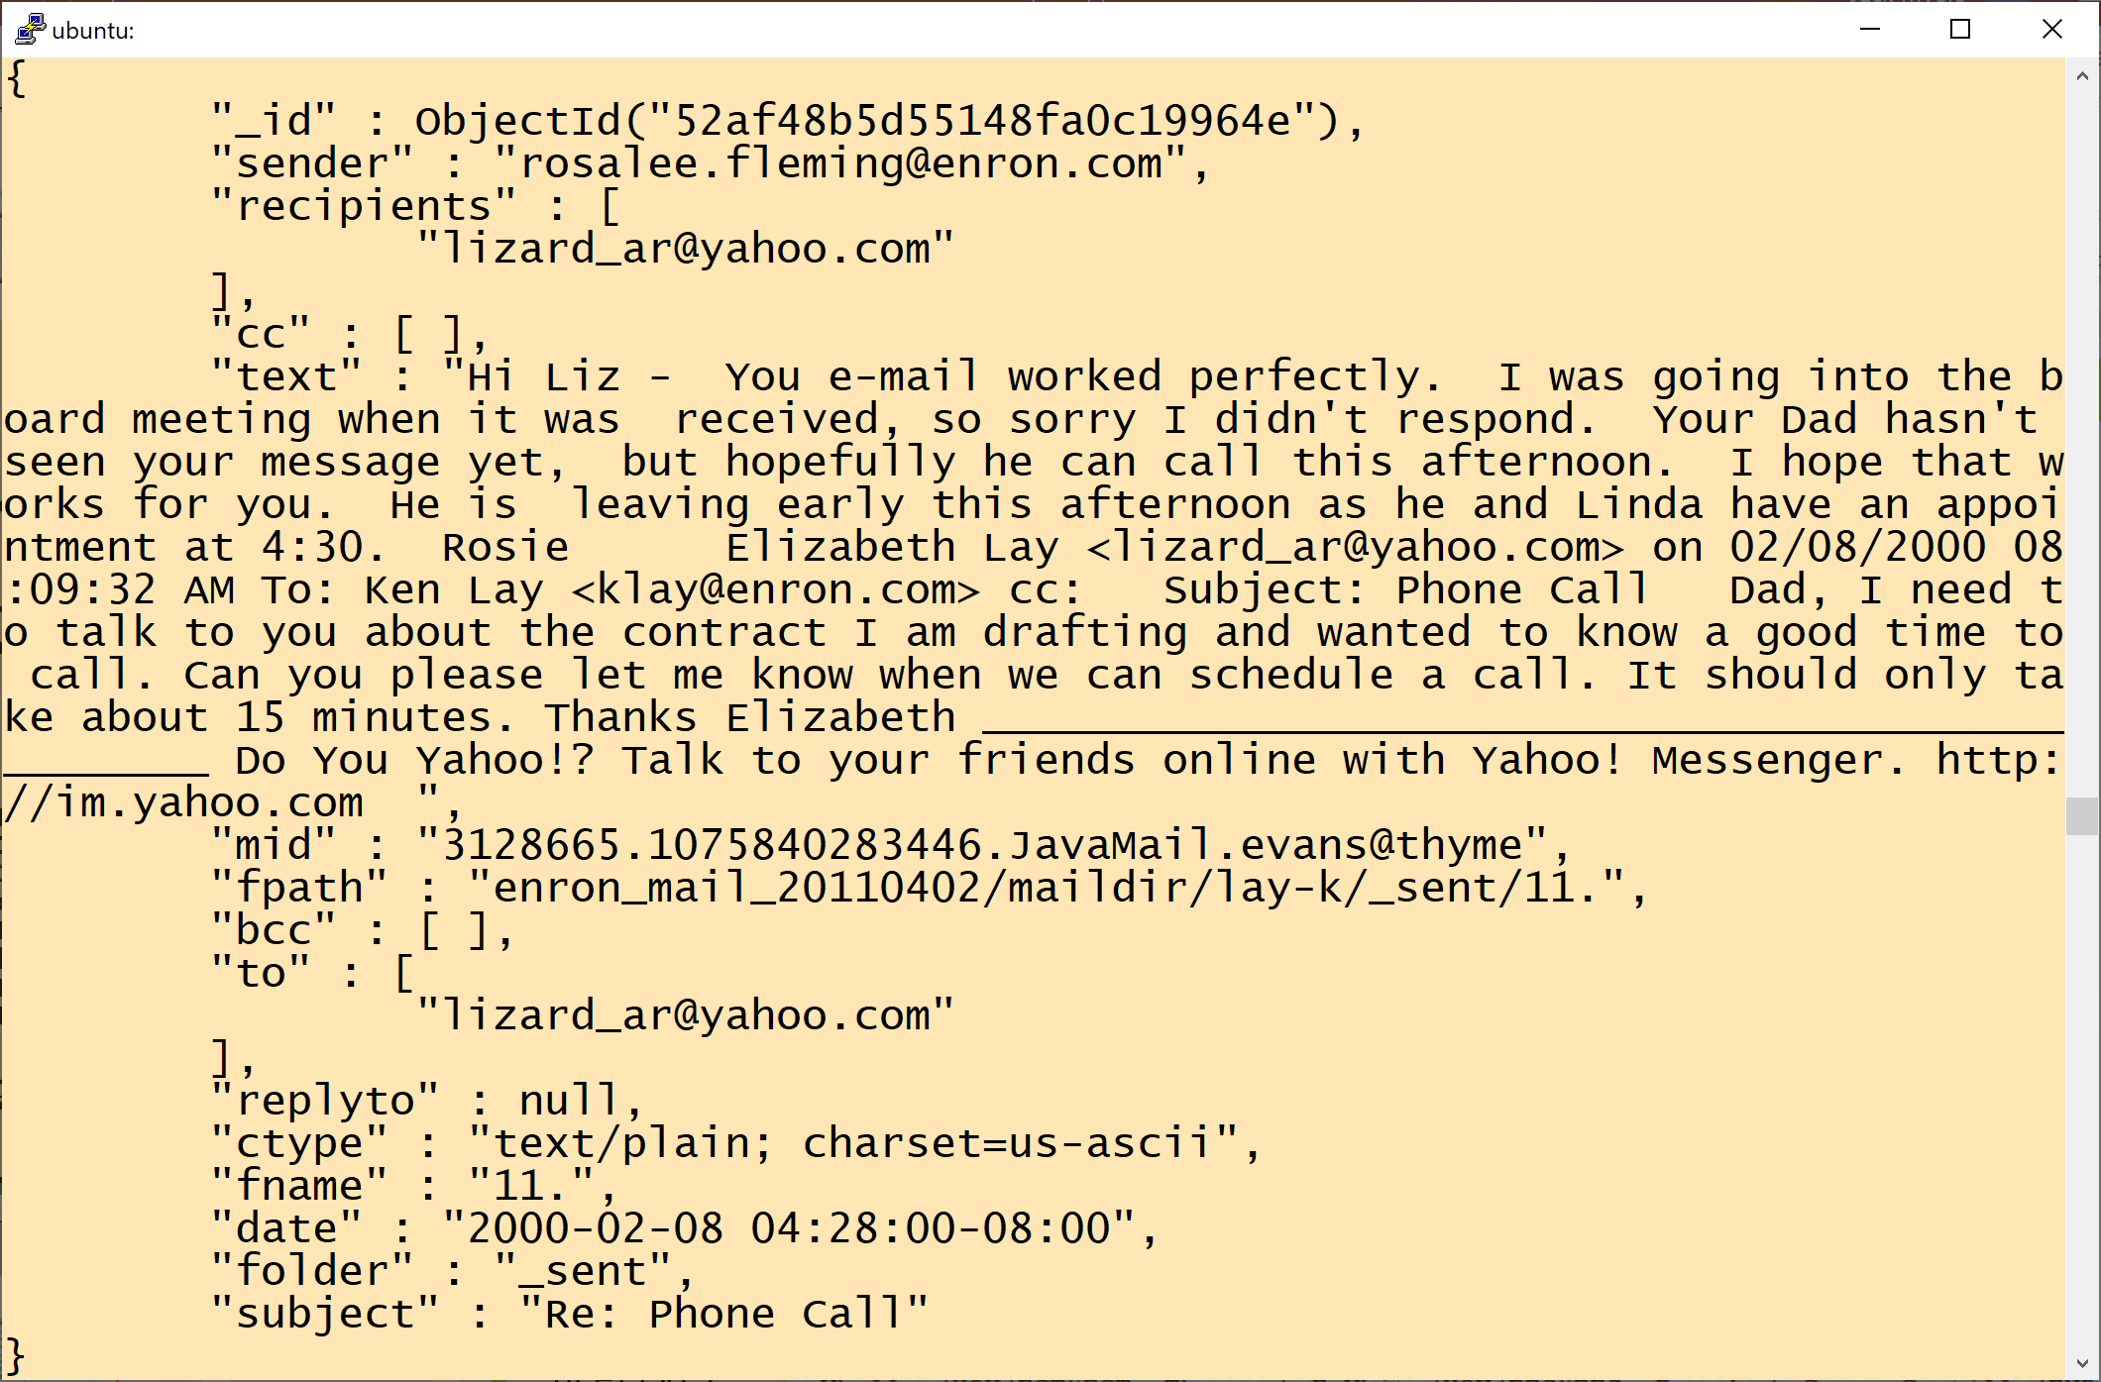
MongoQueries
use command to connect to a particular database
db displays current database
db.email. find() equivalent to SELECT * FROM email
.pretty() shows the data in a readable JSON format

Slide 21
More Queries
db.email.find( {sender : "rosalee.fleming@enron.com"} ).pretty()
Is equivalent to SELECT * FROM email WHERE sender = "rosalee.fleming@enron.com"
db.email.findOne( {sender : "rosalee.fleming@enron.com"} )
Is equivalent to SELECT * FROM email WHERE sender = "rosalee.fleming@enron.com" LIMIT 1 findOne is always pretty!

Slide 22
To quote or not to quote
Enclosing the keys in Mongo in quotes is optional

Slide 23
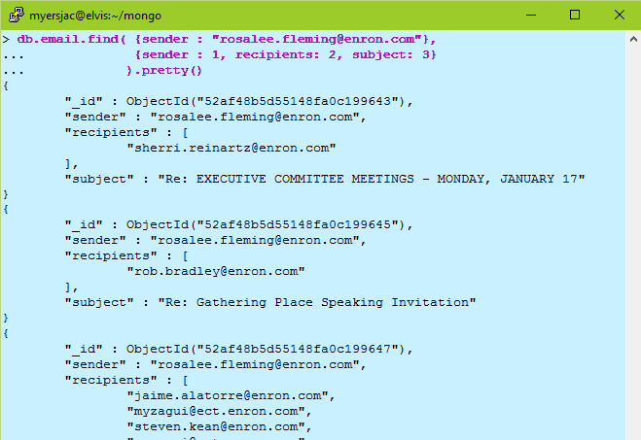
More Queries
db.email.find( {sender : "rosalee.fleming@enron.com"}, {sender : 1, recipients: 2, subject: 3} ).pretty()
equivalent to
SELECT sender, recipients, subject FROM email WHERE sender = "rosalee.fleming@enron.com"

Slide 24
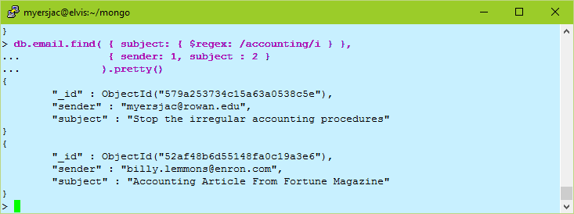
More Queries
db.email.find( { subject: { $regex: /accounting/i } },
{ sender: 1, subject : 2 }
).pretty()
is equivalent to
SELECT * FROM email WHERE subject like '%accounting%'
/i means case insensitive

Slide 25
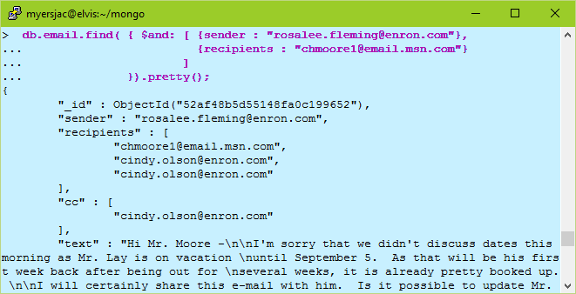
Boolean AND
db.email.find( { $and: [ {sender : "rosalee.fleming@enron.com"},
{recipients : "chmoore1@email.msn.com"}
]
}).pretty()

Slide 26
Complex Boolean Expressions
db.invoice.find( { $and : [ { $or : [ {price : 0.99}, {price : 1.99} ] }, { $or : [ {sale : true}, {qty : {$lt : 20}} ] } ]
} )
This query will return all select all documents where:
the price field value equals 0.99 or 1.99, and
the sale field value is equal to true or the qty field value is less than 20.

Slide 27
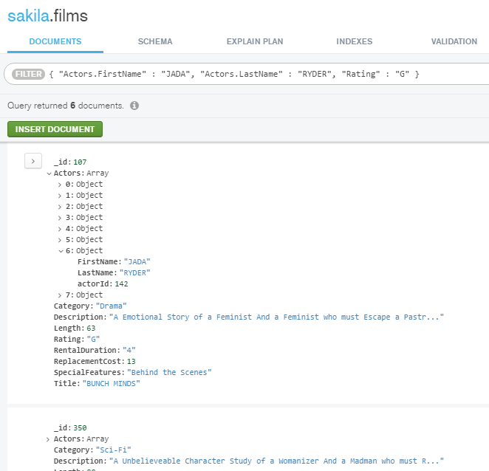
Querying fields in sub-documents
Use the outer document field name to get to the inner document field.

Slide 28
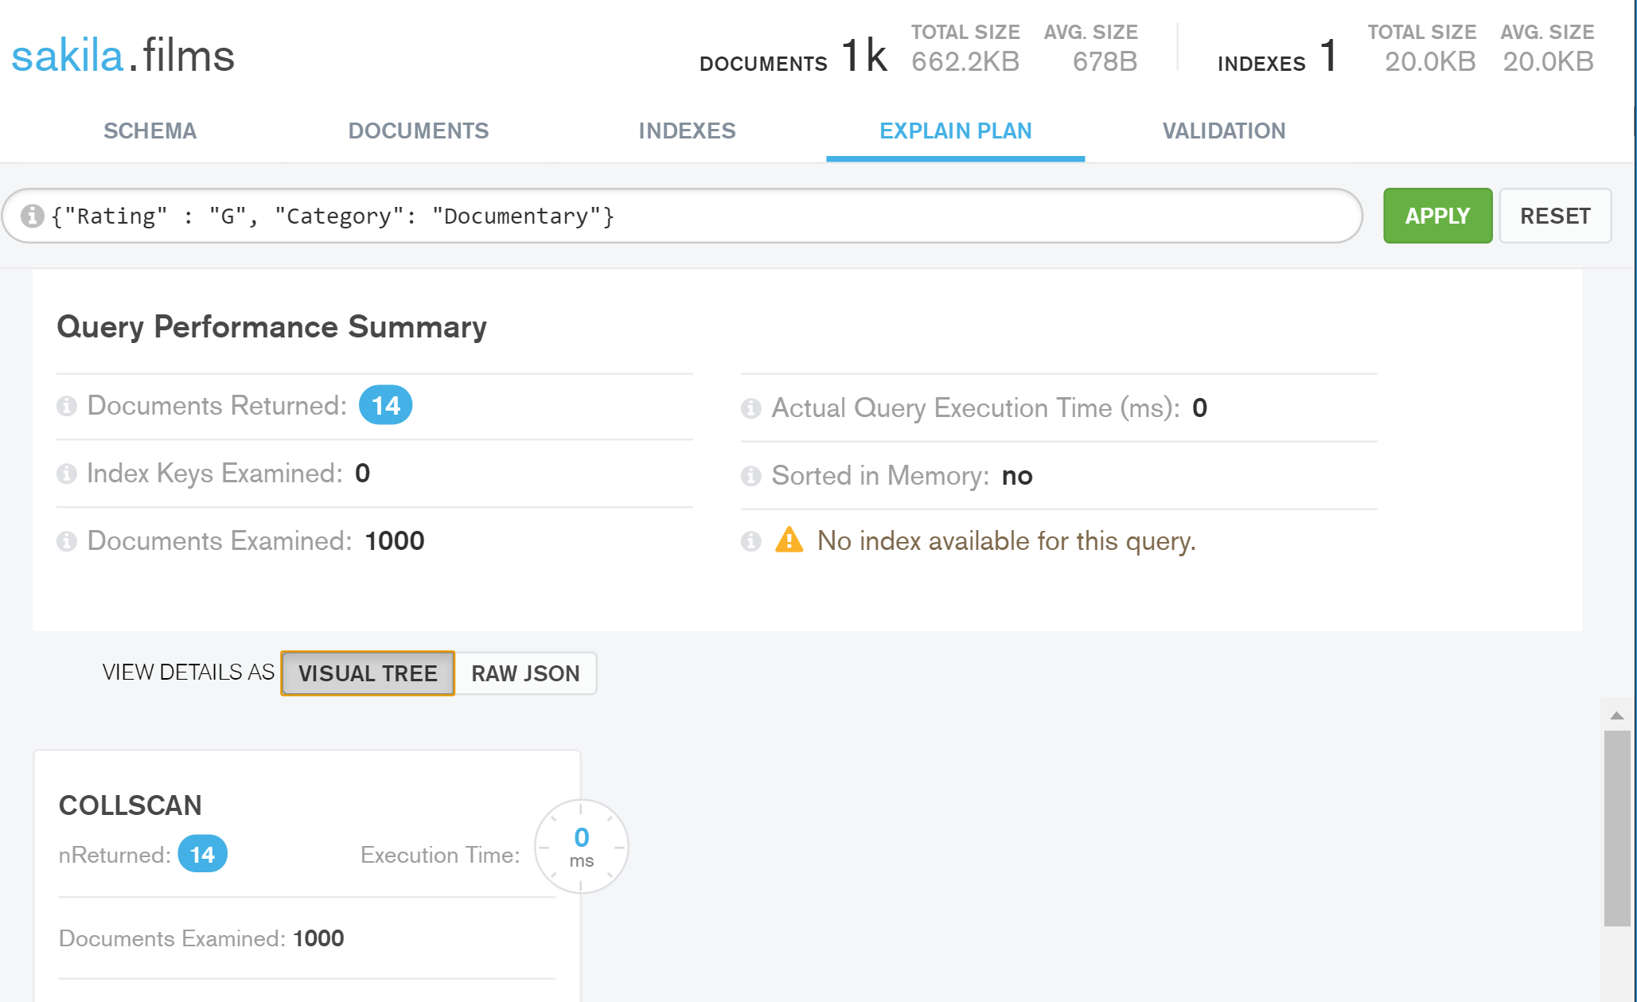
Mongo Compass has an Explain Plan

Slide 29
On server

Slide 30
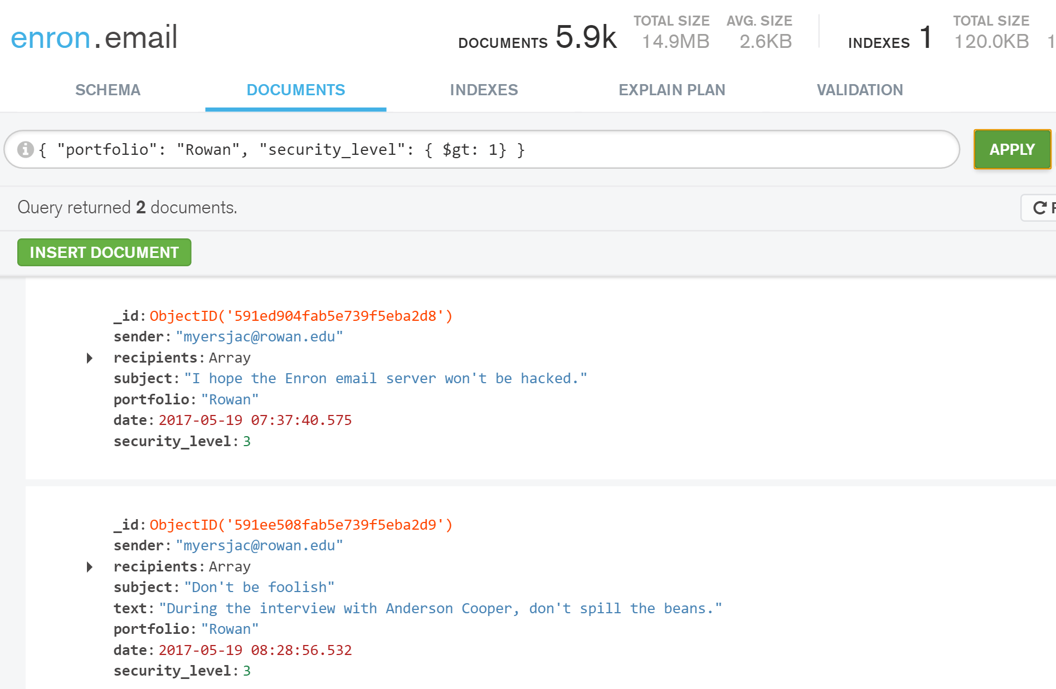
More Queries

Slide 31
MongoDB Syntax: DML

Slide 32
Before we begin…
You will create a Mongo database using your username on the database server. For example, if your username was myersj47… > use myersj47

Slide 33
Creating Documents
The insert function adds a document to a collection.
Variables are used in the MongoDB shell. For instance the command db is really just a request to the shell to echo the value of the variable db.
Create a local variable called post that is a JavaScript object representing our document. > post = {"title" : "My Blog Post", ... "content" : "Here's my blog post.", ... "date" : new Date()}
This object is a valid MongoDB document, so we can save it to the blog collection using the insert command
> db.blog.insert(post)

Slide 34
One-step Insert without Variable
Inserting is easy. Note that you can add the "portfolio" attribute on the fly.

Slide 35
Bulk Insert
Insert an array of objects
db.people.insert([ { name : "Bruno Mars", profession: "Singer" }, { name : "Emma Watson", profession: "Actor" }, { name : "Christopher Nolan", profession: "Director" } ])

Slide 36
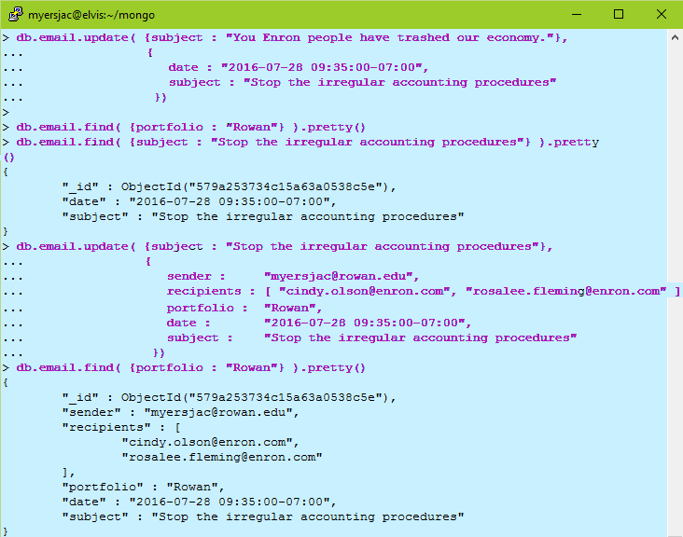
Updating a document: Replace
Updating using only field:value expressions
The update() method replaces the matching document with the <update> document.
The update() method does not replace the _id value.

Slide 37
Updating a document
If the <update> document contains update operator modifiers, such as those using the $set modifier, then:
The <update> document must contain only update operator expressions.
The update() method updates only the corresponding fields in the document.

Slide 38
Deleting in Mongo
Statement 1: How to find using _id
Statement 2: Removing by _id
Statements 3, 5: Getting the document count
Statement 4: Removing everything (matching against the empty filter document {}
You can use any filter, e.g., { portfolio: "Rowan" } in the remove function

Slide 39
Joins? Aggregation?
Document-oriented databases such as MongoDB are designed to store denormalized data. Ideally, there should be no relationship between collections. If the same data is required in two or more documents, it must be repeated.
Joins and Other Aggregation Enhancements were added in MongoDB 3.2 (November 2015) see http://jackmyers.info/db/readings/mongodb_whats_new_3.2.pdf
Adding constraints: "Validating Documents in MongoDB 3.2"
Joins: "Dynamic Lookup: Bringing Left Outer JOINs to MongoDB"

Slide 40
Aggregation Framework
The aggregation framework lets you transform and combine documents in a collection. Basically, you build a pipeline that processes a stream of documents through several building blocks: filtering, projecting, grouping, sorting, limiting, and skipping.
For example, if you had a collection of magazine articles, you might want find out who your most prolific actors were. Assuming that each movie is stored as a document in MongoDB, you could create a pipeline with several steps:
Project the actors out of each movie document.
Group the actors by name, counting the number of occurrences.
Sort the actors by the occurrence count, descending.
Limit results to the first five.

Slide 41
Simple aggregation
db.shakespeare.aggregate([
{ $match : { type : "line", play_name: "macbeth" } },
{ $group : { _id : "$speaker", count : { $sum : 1 } } },
{ $match : { count : { "$gt" : 50 } } },
{ $sort : { count : -1 } },
{ $out : "macbethLines" } ]);
$match is your query criteria ("where clause")
$group is equivalent to "group by"
$match after $group is equivalent to "having"
$sort is equivalent to "order by"
$out is optional, but it will store the results in a new collection

Slide 42
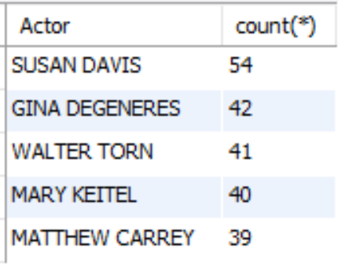
But simple SQL can be daunting in MongoDB
SELECT concat(first_name, " ", last_name) as Actor, count(*) FROM film_actor JOIN actor USING (actor_id) GROUP BY Actor ORDER BY 2 desc LIMIT 5;`

Slide 43
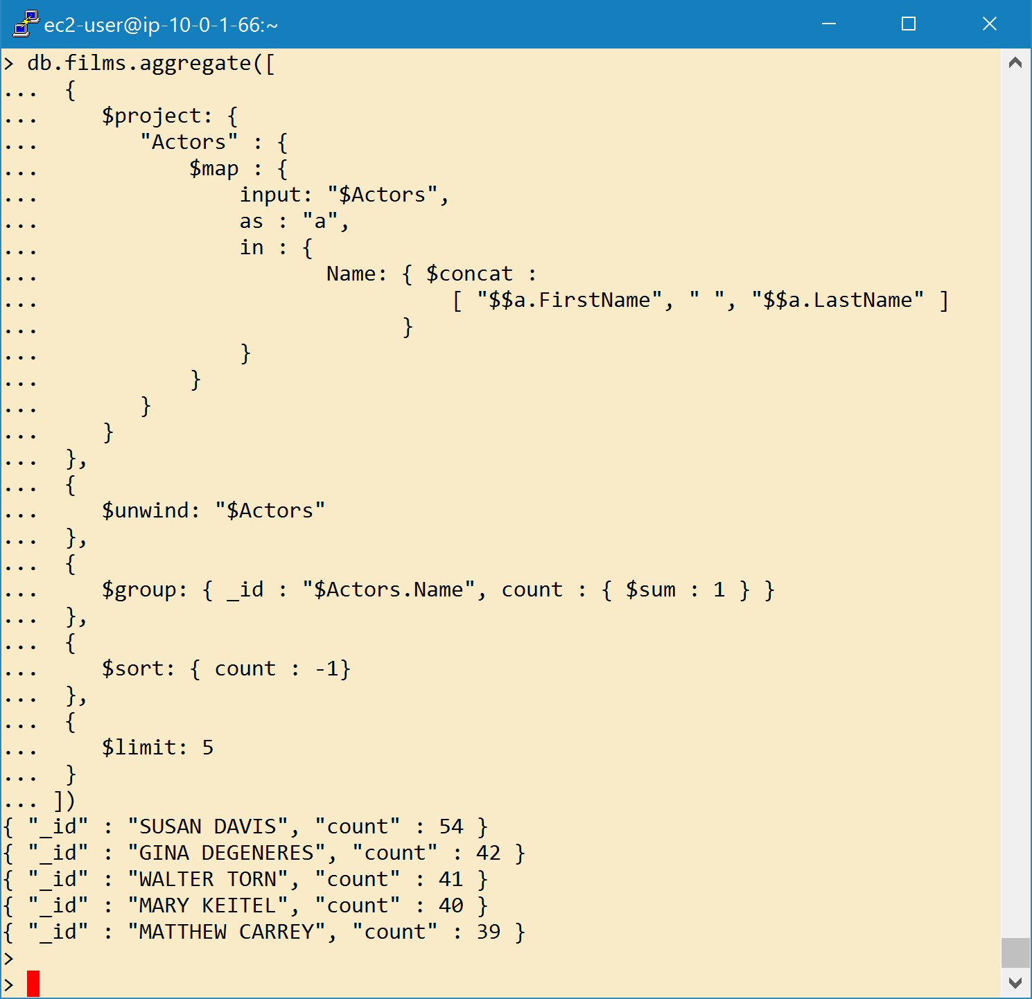

In Mongo (1)
Aggregate takes several operations
$project Determines what fields returned.
$map Applies an expression to each item in an array and returns an array with the applied results
Input – the array
As – the variable name
In – the expression to apply
$unwind Make each Actor its own row. Simulates JOIN results, makes demormalized table
Unwound Actors for movie id 1 (ACADEMY DINOSAUR)
{ "_id" : 1, "Actors" : { "Name" : "PENELOPE GUINESS", "actorid" : 1 } }
{ "_id" : 1, "Actors" : { "Name" : "CHRISTIAN GABLE", "actorid" : 10 } }

Slide 44
In Mongo (2)
Aggregate takes several operations
$group groups the actors by name and increments "count" for each document an actor appears in.
Specify the field to group by, which is "Actors.Name". This is indicated by the "_id" field.
You can picture this as: after the group there will be one result document per actor name, so "Actors.Name" becomes the unique identifier ("_id").
The second field means to add 1 to a "count" field for each document in the group.

Slide 45
In Mongo (3)
Aggregate takes several operations
$project
$unwind
$group
$sort This reorders the result documents by the "count" field from greatest to least.
$limit This limits the result set to the first five result documents.

Slide 46
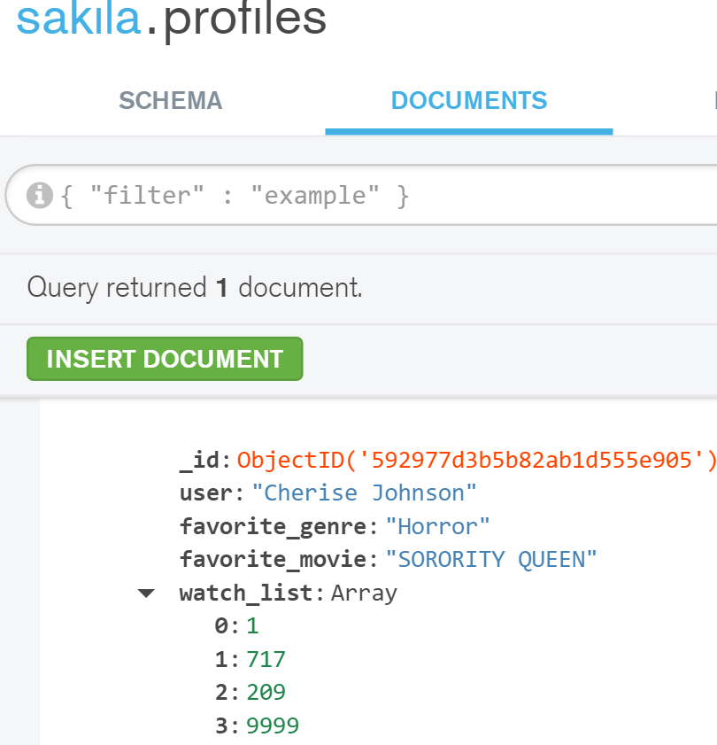
JOIN example
Here is a record in sakila.profiles
Cherise has listed her favorite movie ("SORORITY QUEEN") and her watch list contains ids from the films collection.
db.profiles.aggregate([
{
$lookup:
{
from: "films",
localField: "favorite_movie",
foreignField: "Title",
as: "fave_movie_info"
}
}
]).pretty()

Slide 47
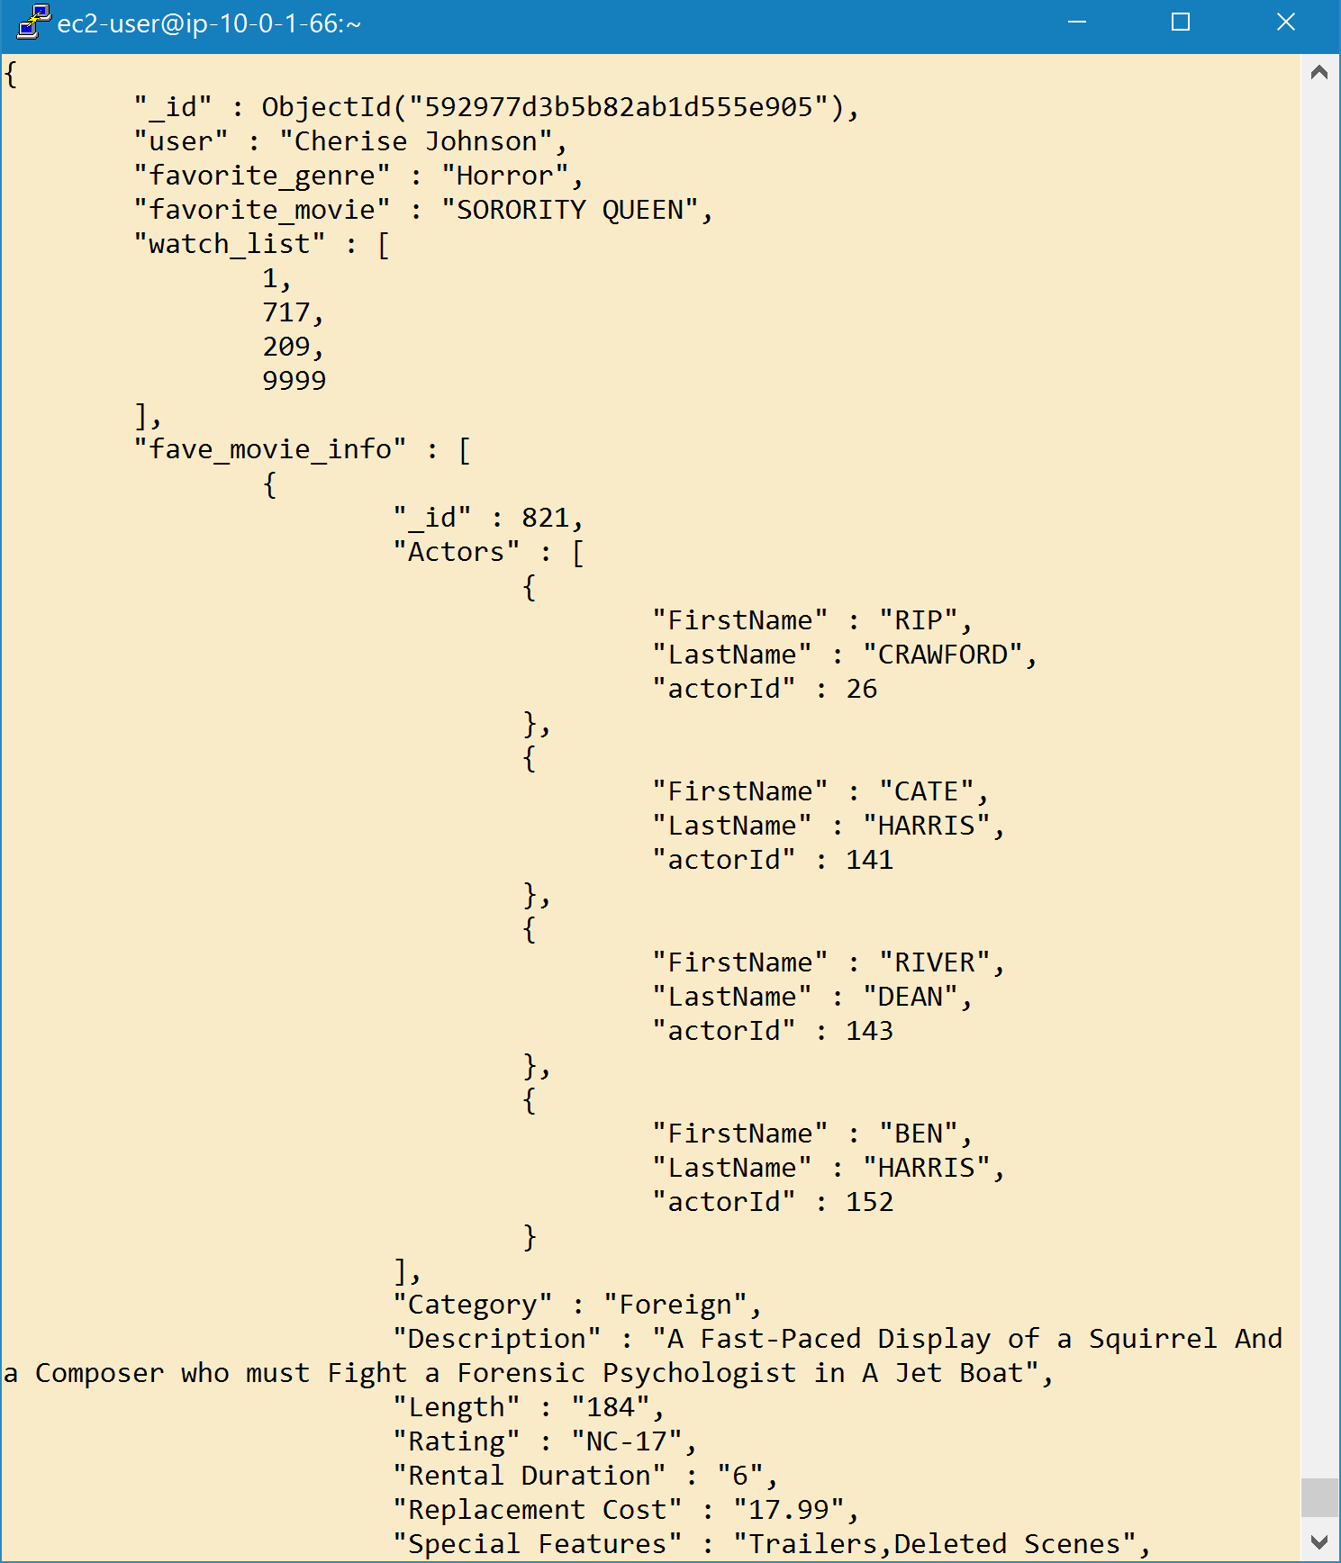
JOIN example
db.profiles.aggregate([
{
$lookup:
{
from: "films",
localField: "favorite_movie",
foreignField: "Title",
as: "fave_movie_info"
}
}
]).pretty()
To each input document, the $lookup stage adds a new array field whose elements are the matching documents from the “joined” collection.

Slide 48
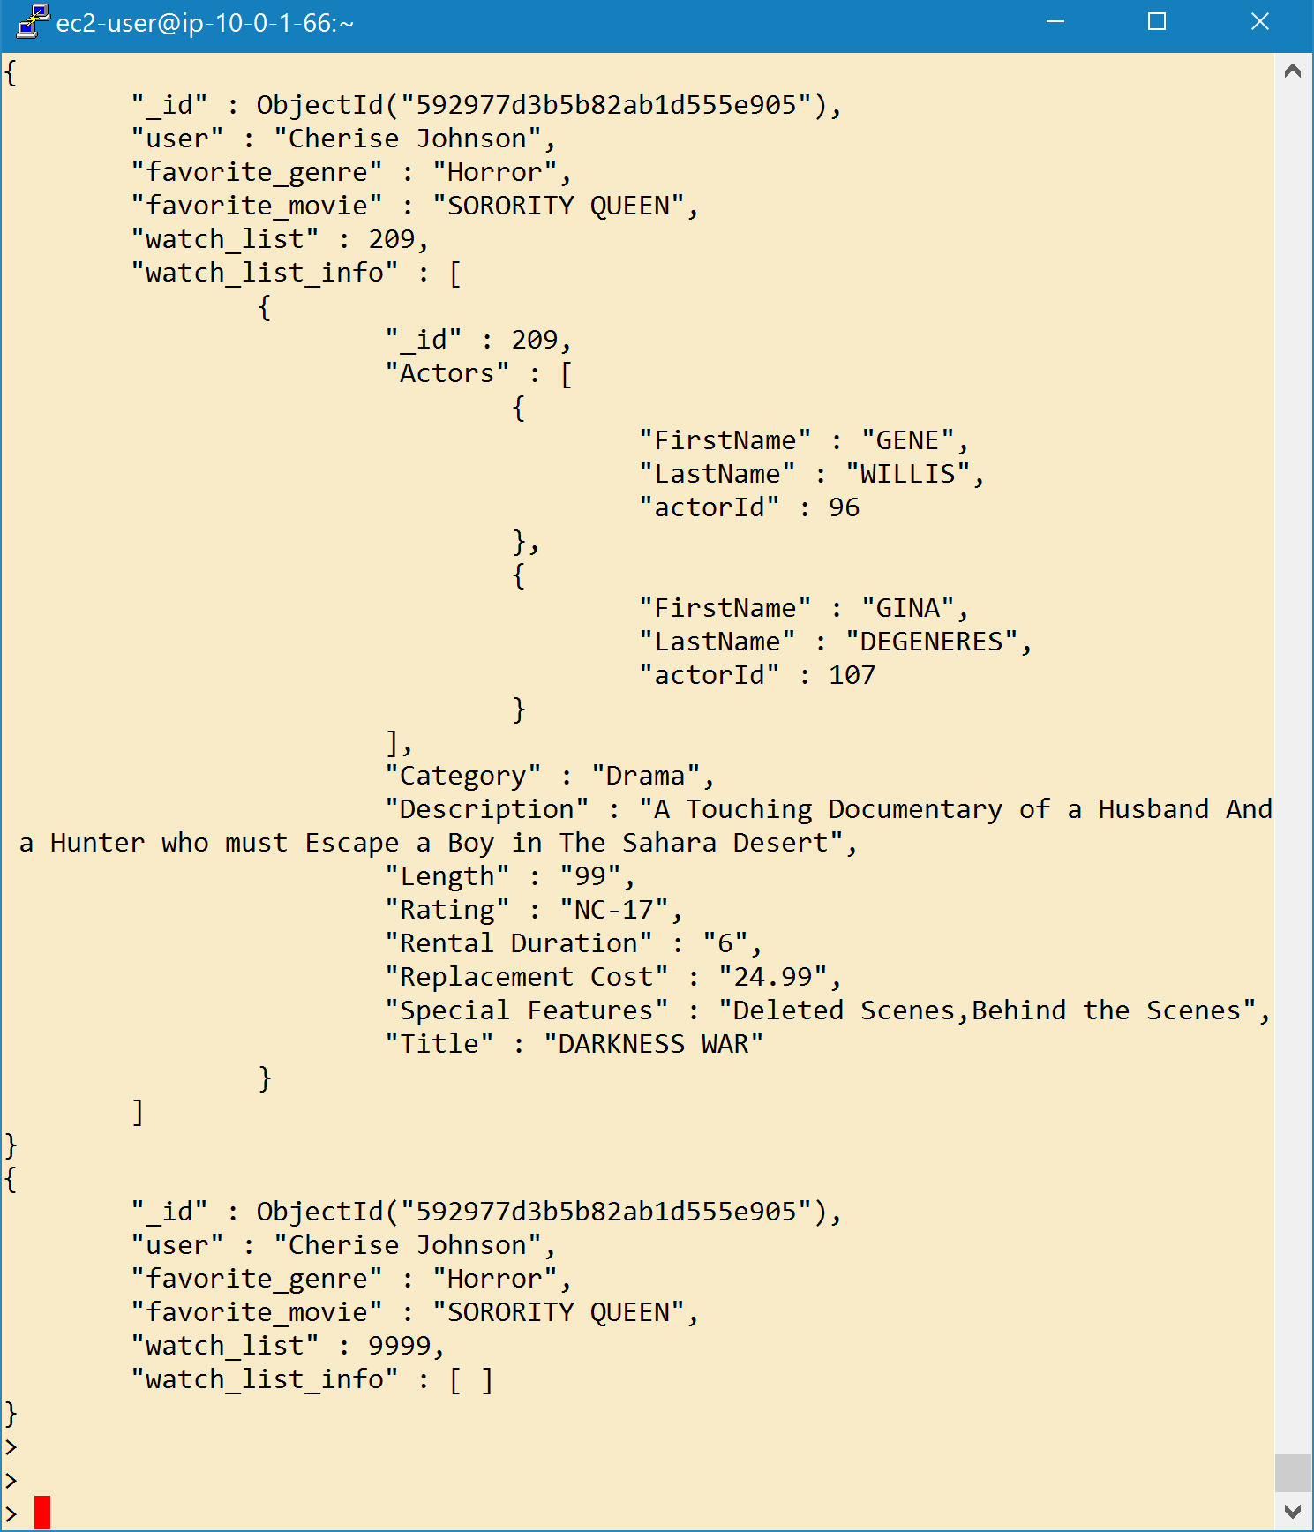
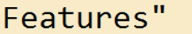
JOIN on array elements
Document for movie id 209
Unwind the array and then lookup
Deconstructs an array field from the input documents to output a document for each element.
db.profiles.aggregate([
{
$unwind: "$watch_list"
},
{
$lookup:
{
from: "films",
localField: "watch_list",
foreignField: "_id",
as: "watch_list_info"
}
}
]).pretty()
Document for movie id 9999
No such movie, but LEFT OUTER JOIN performed

Slide 49
Advanced Mongo

Slide 50
Scripting for Mongo

Slide 51
Why use Map-reduce
MongoDB is partially written in JavaScript. So, it can be interacted with using javascript files.
You cannot use any shell helper (e.g. use <dbname>, show dbs, etc.) inside the JavaScript file because they are not valid JavaScript.
Excellent for complex Mongo queries. Who really wants to type these long queries in the command shell?
Scripts can be run outside of Mongo from the command line, or inside of mongo using load("<scriptname>");

Slide 52
Example: Shakespeare Aggregation (1)
// Run from shakespeare database. Javascript alternative for "use"
db = db.getSiblingDB('shakespeare');
// Show the number of documents
numdocs = db.shakespeare.count();
print("There are " + numdocs + " documents in collection.\n");
// Sample Macbeth long line
print("Here is a sample line from Macbeth.");
someMacbeth = db.shakespeare.findOne(
{
play_name : "macbeth", type : "line",
$expr : { $gt : [ { $strLenCP : "$text_entry" }, 20 ] }
},
{ line_id : 1, play_name : 2, speaker : 3, text_entry: 4 }
);
printjson(someMacbeth);

Slide 53
Example: Shakespeare Aggregation (1)
// Aggregation framework to find number of speaker lines in Macbeth
db.shakespeare.aggregate( [
{ $match : { type : "line", play_name: "macbeth" } },
{ $group : { _id : "$speaker", count : { $sum : 1 } } },
{ $sort : { count : -1 } },
{ $out : "macbethLines" } ]);
print("Here's how many lines the top 20 speakers had.");
cursor = db.macbethLines.find().limit(20);
while ( cursor.hasNext() ) {
printjson( cursor.next() );
}

Slide 54
Example: Shakespeare Aggregation OUTPUT
> load("shakespeare_aggregation.js");
There are 222792 documents in collection.
Here is a sample line from Macbeth.
{
"_id" : ObjectId("5f45209df6ddf41015ef5831"),
"line_id" : 55782,
"play_name" : "macbeth",
"speaker" : "ADRIANO DE ARMADO",
"text_entry" : "Thunder and lightning. Enter three Witches"
}
Here's how many lines the top 20 speakers had.
{ "_id" : "MACBETH", "count" : 773 }
{ "_id" : "LADY MACBETH", "count" : 278 }
{ "_id" : "MALCOLM", "count" : 219 }
{ "_id" : "MACDUFF", "count" : 192 }
{ "_id" : "ROSS", "count" : 137 }
{ "_id" : "BANQUO", "count" : 121 }
{ "_id" : "DUNCAN", "count" : 79 }
{ "_id" : "LENNOX", "count" : 78 }
{ "_id" : "First Witch", "count" : 67 }
...

Slide 55
MongoDB Design Patterns

Slide 56
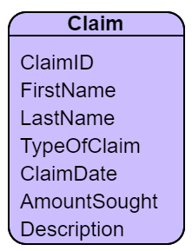
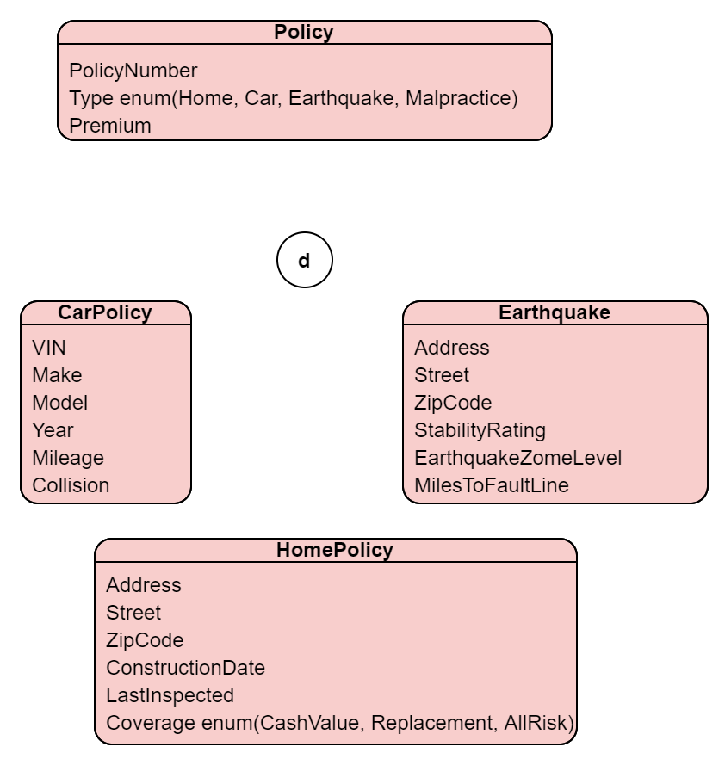
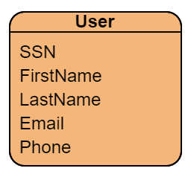
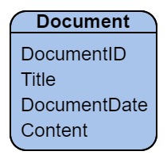
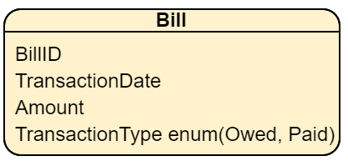

How to Model this in Mongo?
Mongo Insurance

Slide 57
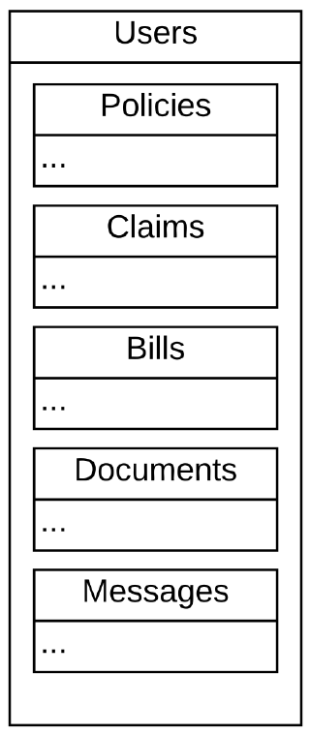
Design Differences
In Relational Modeling, the data drives the model
In Document Modeling, the application drives the model
Mongo allows complete embedding (see picture), but is that always the best?

Slide 58
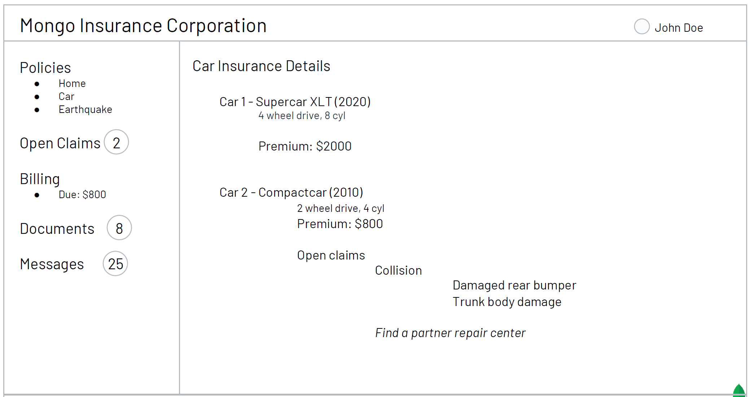
Main Page of Portal: Must Load Very Quickly

Slide 59
Mongo Design Patterns
Real-time Analytics
Content Mgmt
Personalization
Catalog
Single View
IoT
Mobile
Approximation | X |  | X | X |  | x
Attribute | X | X |  |  |  |  | x
Bucket |  |  | X |  |  | X
Computed | X |  | X | X | X | X | X
Document Versioning | X | X |  |  | X |  | X
Extended Reference | X |  |  | X |  | X
Outlier |  |  | X | X | X
Polymorphic | X | X |  | X |  |  | X
Schema Versioning | X | X | X | X | X | X | X
Subset | X | X |  | X | X
Tree | X | X

Slide 60
Patterns from Videos
"Data Modeling with Mongo DB"
Schema Versioning Pattern (15:46)
Add schema_version field; deal with legacy documents differently
The Bucket Pattern (19:00, also Advanced (Mongo) Schema Design 20:30)
Group frequent measurements in a bucket with defined beginning and end to avoid making too many documents
"Advanced (Mongo) Schema Design"
The Computed Pattern (14:20, also Data Modeling with MongoDB 25:34)
Pre-calculations, store summarized results to save CPU
The Extended Reference Pattern (16:00)
Store keys to other objects. A bit like relational $lookup instead of Joins
The Outlier Pattern (24:00)
Outliers or "overflow recoreds" (perhaps 20% of records) are stored elsewhere
The Approximation Pattern (28:19)
If accuracy is not critical, will approximations do?

Slide 61
Attribute Pattern
Attribute Pattern ("the 1NF pattern")
When an attribute has multiple values, which mean different things, break them into documents
{
title: "Star Wars",
director: "George Lucas",
…
releases: [
{
location: "USA",
date: ISODate("1977-05-20T01:00:00+01:00")
},
{
location: "France",
date: ISODate("1977-10-19T01:00:00+01:00")
},
{
location: "Italy",
date: ISODate("1977-10-20T01:00:00+01:00")
},
{
location: "UK",
date: ISODate("1977-12-27T01:00:00+01:00")
},
…
],
…
}
{ title: "Star Wars", director: "George Lucas",
...
release_US: ISODate("1977-05-20T01:00:00+01:00"), release_France: ISODate("1977-10-19T01:00:00+01:00"), release_Italy: ISODate("1977-10-20T01:00:00+01:00"), release_UK: ISODate("1977-12-27T01:00:00+01:00"), ... }D

Slide 62
The Document Versioning Pattern
The Document Versioning Pattern makes a few assumptions about the data in the database and the data access patterns that the application makes.
Each document doesn’t have too many revisions.
There aren’t too many documents to version.
Most of the queries performed are done on the most current version of the document.
Collection: CurrentPolicies
{ _id: ObjectID("7df78ad8902c")
policy_number: "101-FG-13A", ssn: "182-23-1291",
type: "Home",
effective_date: ISODate("2020-10-20"),
coverage("fire/smoke", "water", "weather")
}
Collection: Policies
{ _id: ObjectID("7df78ad8902c")
policy_number: "101-FG-13A", ssn: "182-23-1291",
type: "Home",
effective_date: ISODate("2020-10-20"),
coverage("fire/smoke", "water", "weather")
},
{ _id: ObjectID("2c13ba39f02c")
policy_number: "101-FG-13A", ssn: "182-23-1291",
type: "Home",
effective_date: ISODate("2019-02-15"),
coverage("fire/smoke", "weather")
}
...
Collection: PriorPolicies
{ _id: ObjectID("2c13ba39f02c")
policy_number: "101-FG-13A", ssn: "182-23-1291",
type: "Home",
effective_date: ISODate("2019-02-15"),
coverage("fire/smoke", "weather")
}
...

Slide 63
Polymorphic and Subset Pattern
Polymorphic Pattern
With a lot of similar attributes at "superclass" level, allow unique subclass attributes
Subset Pattern
A bit like Bucket Pattern. To avoid large documents store a subset of the data
For example, in a Product document store only the last 10 reviews.
Older reviews could be stored in a Reviews collection with a like to the Product.

Slide 64
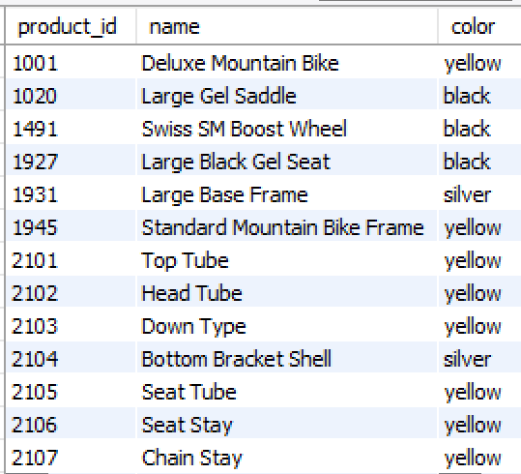
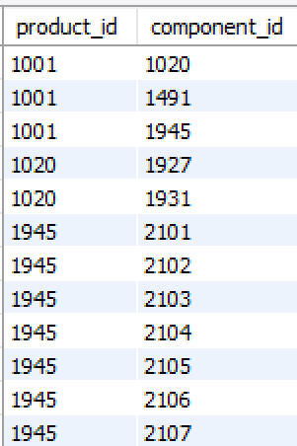
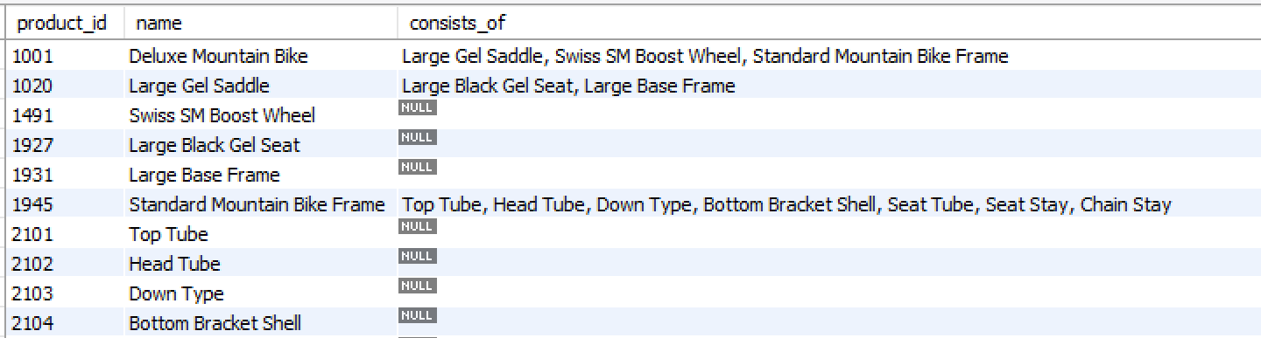
Tree Pattern
Remember those parent child relationships, self-joins and group_concats?
WITH component_view AS (SELECT p.product_id, p.name, p.color, c.component_id, p2.name as component_name FROM products LEFT JOIN components c ON (p.product_id = c.product_id) LEFT JOIN products p2 ON (c.component_id = p2.product_id) ) SELECT product_id, name, group_concat(component_name separator ', ') as consists_of FROM component_view GROUP BY product_id;

Slide 65
Tree Pattern
Encode a list of parents or a list of children
Alternatively, encode a list of _ids [ 1020, 1491, 1945 ]
or encode a list of documents
[{ _id : 1020}, { ...
{
_id : 1001, name : "Deluxe Mountain Bike",
color : "yellow", consists_of : ["Large Gel Saddle", "Swiss BM Boost Wheel", "Standard Mountain Bike Frame"]
}.
{
_id : 1020, name : "Large Gel Saddle",
color : "black",
consists_of : ["Large Black Gel Seat", "Large Base Frame"]
},

Slide 66
Map-reduce

Slide 67
Why use Map-reduce
MongoDB supports map-reduce to operate on huge data sets to get the desired results in much faster way.
Map-reduce has two main functions:
A map function which groups all the data based on the key value
A reduce function which performs operation on the mapped data.
The data is independently mapped and reduced in different shards and then combined together and finally reduced to give a single result. Map-reduce function is performed on the data independently and in parallel.

Slide 68
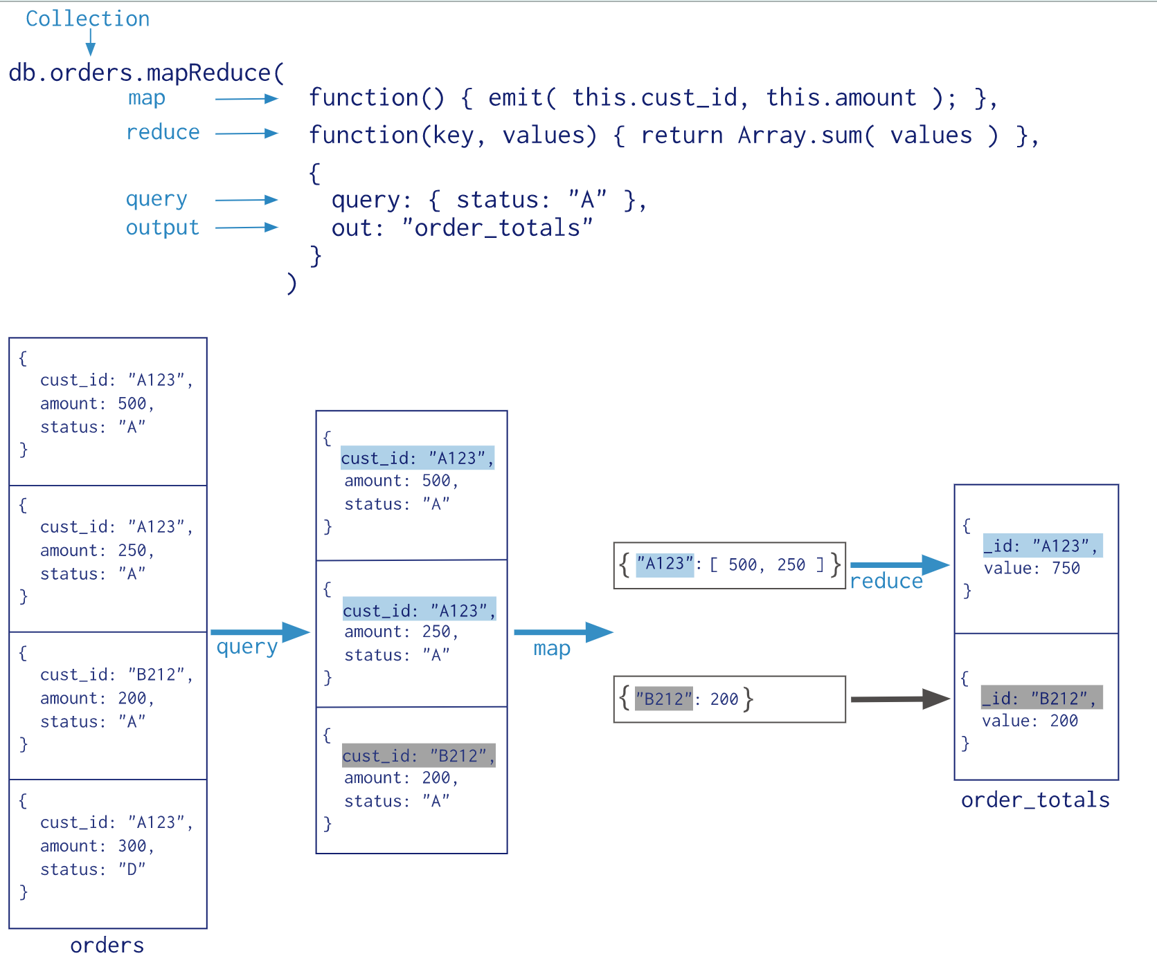
Map-reduce
Map-reduce condenses large volumes of data into useful aggregated results.
MongoDB applies the map phase to each input document (i.e. the documents in the collection that match the query condition). The map function emits key-value pairs.
For those keys that have multiple values, MongoDB applies the reduce phase, which collects and condenses the aggregated data.
the key value pair
The reduce function will return a single value based on the array of values for each key
Whatever you emit yields an array of values for each distinct key

Slide 69
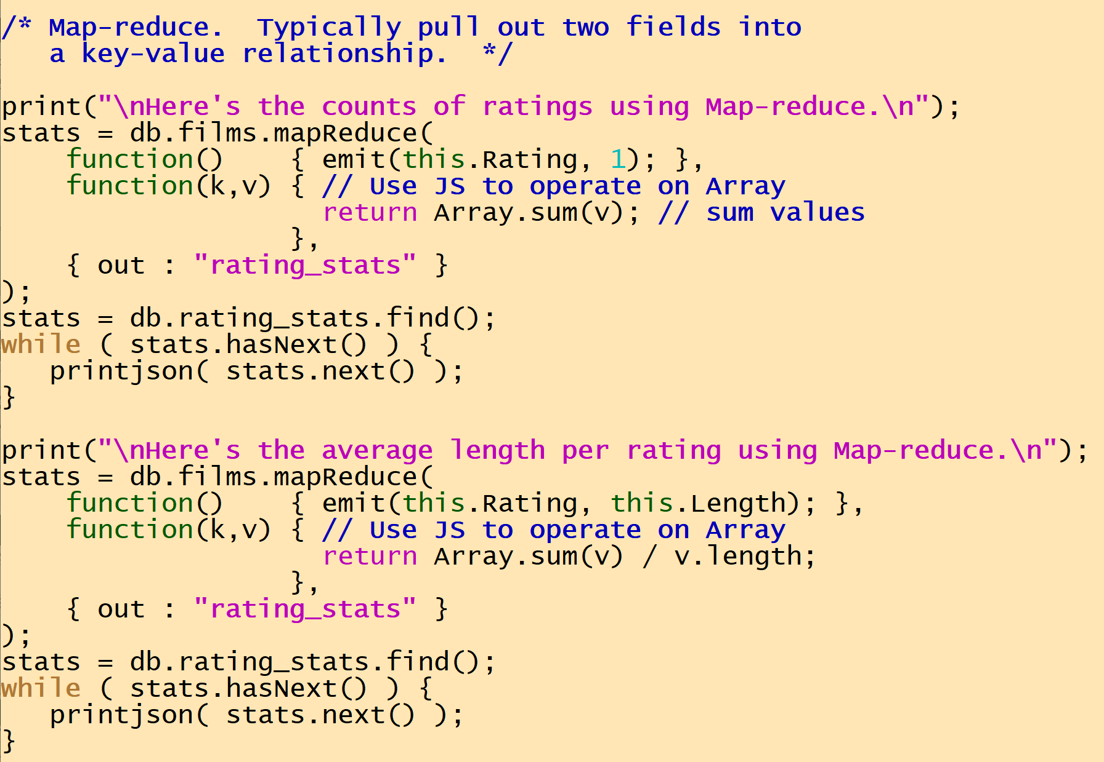
Examples (1)
Here's the counts of ratings using Map-reduce.
{ "_id" : "G", "value" : 178 }
{ "_id" : "NC-17", "value" : 210 }
{ "_id" : "PG", "value" : 194 }
{ "_id" : "PG-13", "value" : 223 }
{ "_id" : "R", "value" : 195 }

Slide 70
Examples (2)
Here's the average length per film using Map-reduce.
{ "_id" : "G", "value" : 105.84776368802915 }
{ "_id" : "NC-17", "value" : 121.15370997565897 }
{ "_id" : "PG", "value" : 113.61561077561805 }
{ "_id" : "PG-13", "value" : 115.24391716556012 }
{ "_id" : "R", "value" : 124.40780760410644 }

Slide 71
Map-reduce vs. Aggregation Framework
When to use map-reduce ?
Map-reduce should be used when your aggregation query is slow and taking longer time to execute because of huge amount of data in the DB. Map-reduce can run parallel and can perform operations at much higher rate.
If the data is less its better to stick to aggregate queries as map reduce takes longer execution times compared to aggregate queries when data set is low.
From https://medium.com/@mallikarjuna91/mongodb-mapreduce-introduction-649f8533f509

Slide 72
Mongo and R

Slide 73
Connecting R to Mongo Using Mongolite
# This is a test of mongo integration with R
# use the Mongolite library
library(mongolite)
# make connection object "m"
m <- mongo("films", url = "mongodb://localhost", db = "sakila")
# Mongo counts
cat("How many films in sakila?\n")
m$count('{}')
cat("How many G films in sakila?\n")
m$count('{"Rating" : "G"}')
R is strict with JSON, please put all keys in quotes.
Mongolite: Fast and simple MongoDB Client for R
Includes support for aggregation, indexing, map-reduce, streaming, encryption, enterprise authentication, and GridFS.
Make a Mongo connection then use <connection>$ functions, such as count.
To run a script inside the r shell, type
source("<script name>")

Slide 74
Querying Mongo from R
# Mongo queries
cat("\nSorority Queen information\n")
cat( "--------------------------\n")
sq <- m$find(
query = '{"Title" : "SORORITY QUEEN"}',
fields = '{"Title" : 1, "Category" : 1, "Rating" : 1, "Length" : 1}',
limit = 1
)
print(sq)
"Title" : 1 translates to Title=true

Slide 75
Iterating Through a Collection
# Iteration
cat("\nLongest R movies\n")
# perform query and return the iterator
it <- m$iterate('{"Rating" : "R"}', sort = '{"Length": -1}', limit = 10)
# read records from the iterator
cat("\n")
while(!is.null(x <- it$one())){
cat(sprintf("Found %d minute film called '%s'\n", x$Length, x$Title))
}

Slide 76
Aggregation
# Aggregation
cat("\nStatistics by Rating\n\n")
# use aggregation pipeline to get film lengths by rating
stats <- m$aggregate(
'[{"$group" : {"_id":"$Rating",
"count" : {"$sum":1},
"average" : {"$avg":"$Length" }
}
},
{"$sort" : { "count" : -1} } ]',
options = '{"allowDiskUse":true}'
)
# name the columns
names(stats) <- c("rating", "count", "average")
print(stats)
# plot the data
library(ggplot2)
ggplot(aes(rating, count), data = stats) + geom_col()
allowDiskUse
Optional. Enables writing to temporary files. When true, aggregation stages can write data to the _tmp subdirectory in the dbPath directory.

Slide 77
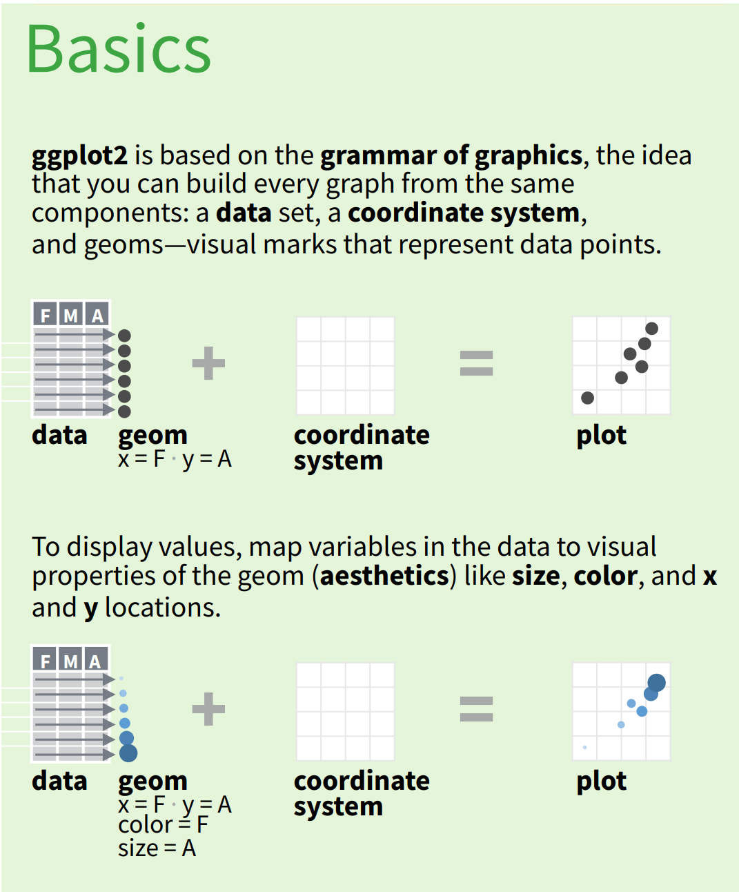
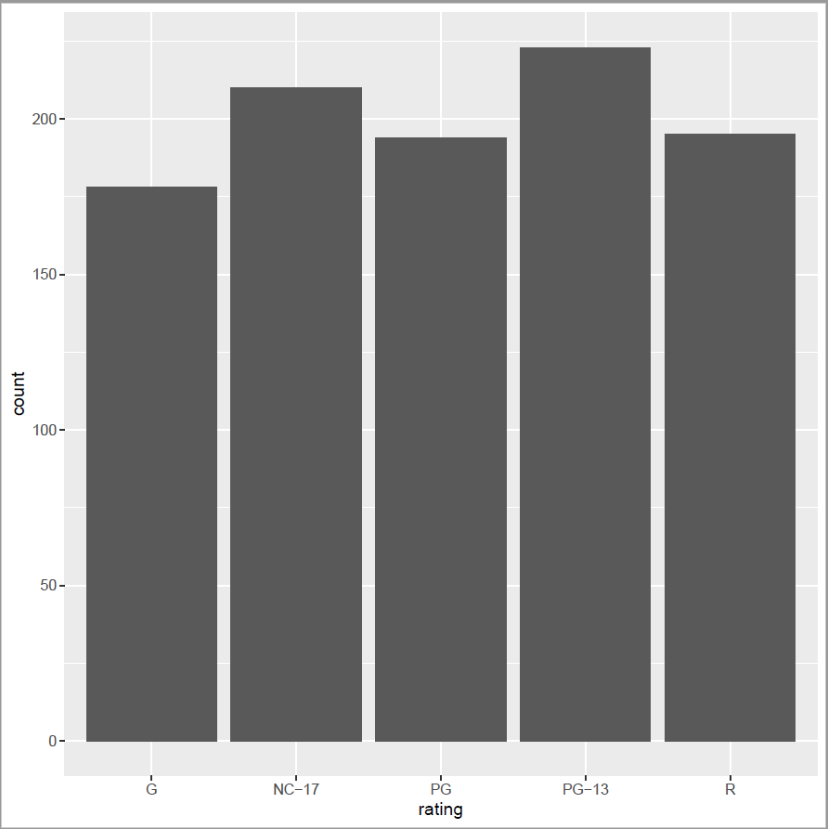
ggplot2
In most cases you start with ggplot(), supply a dataset and aesthetic mapping (with aes()).
ggplot(aes(rating, count), data = stats) + geom_col()

Slide 78
ggplot for Scatter plots
Is there a correclation between number of lines a character recites and their average lenghth? That is, do major characters have longer lines than minor characters?
stats <- s$aggregate(
'[ { "$match" : { "type" : "line' <and maybe other criteria> } },
{ "$project" : {
"speaker" : 1,
"length" : { "$strLenCP" : "$text_entry" }
}
},
{ "$group" : {
"_id" : "$speaker",
"avg_line_length" : { "$avg" : "$length" },
"number_of_lines" : { "$sum" : 1 }
}
},
{ "$sort" : { "number_of_lines" : -1 } }
]')
ggplot(data = stats) +
geom_point(mapping = aes(x = number_of_lines,
y = avg_line_length) )

Slide 79
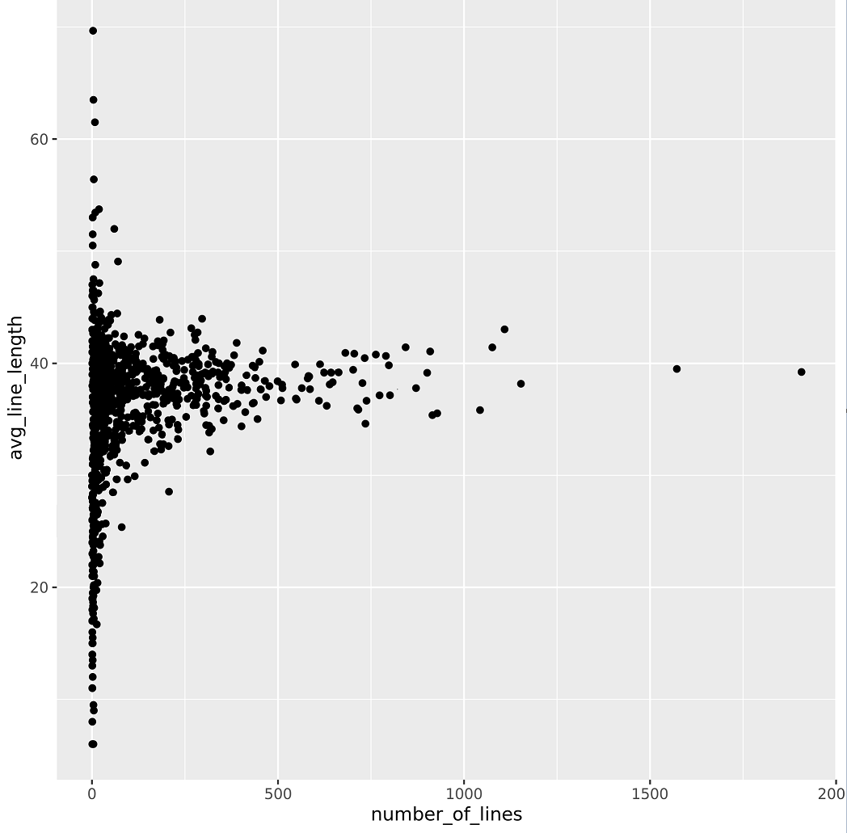


Shakespeare Scatter Plot #1
"$match" : { "type" : "line' }
We see an average line length of about 39 characters
We see a huge variation in line length of characters with a small number of lines.
_id avg_line_length #_of_lines
Sentinels 69.66667 3
Crier 63.50000 4
GARDENER 61.50000 8
Here's a line from the Sentinels in Henry VI Part 2: "The French leap over the walls in their shirts. Enter, several ways, the BASTARD OF ORLEANS, ALENCON, and REIGNIER, half ready, and half unready
Hamlet (known for his long soliloquies)
db.shakespeare.find( { speaker : "Sentinels", type : "line" }, { speaker : 1, text_entry : 1, play_name : 1 })

Slide 80
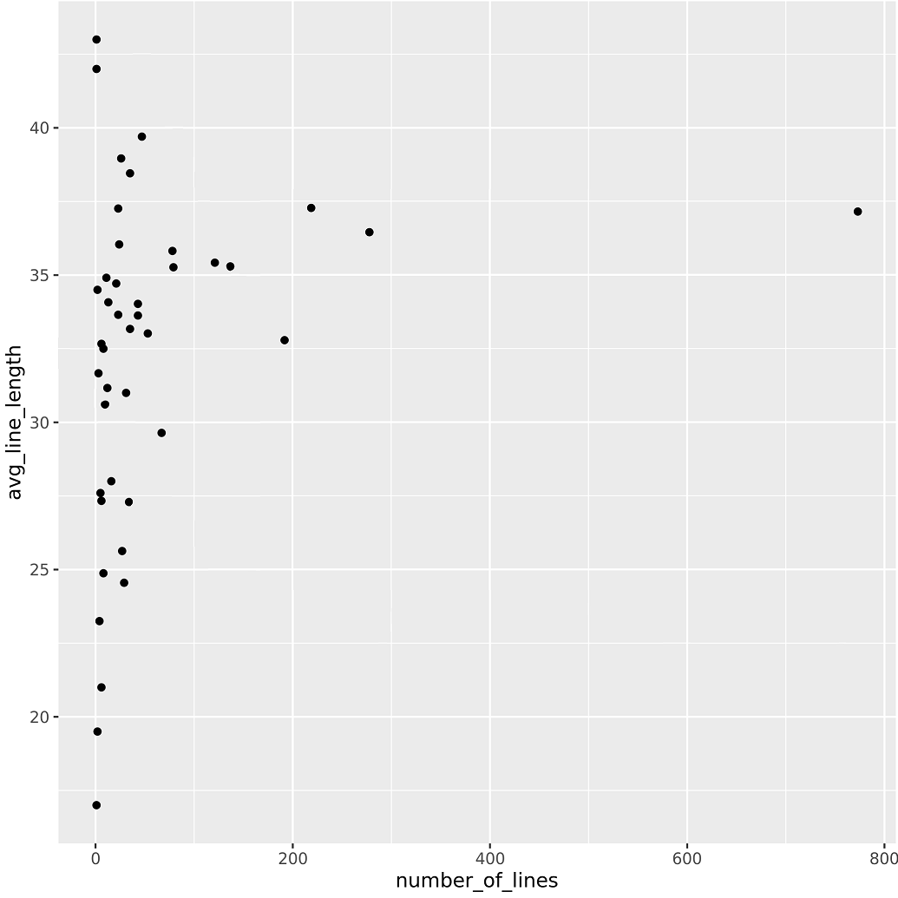
Shakespeare Scatter Plot #2
"$match" : { "type" : "line', "play_name" : "macbeth" }
We see an average line length of about 39 characters
We see a huge variation in line length of characters with a small number of lines.
Malcolm
Lady Macbeth
Macbeth
Macduff

Slide 81
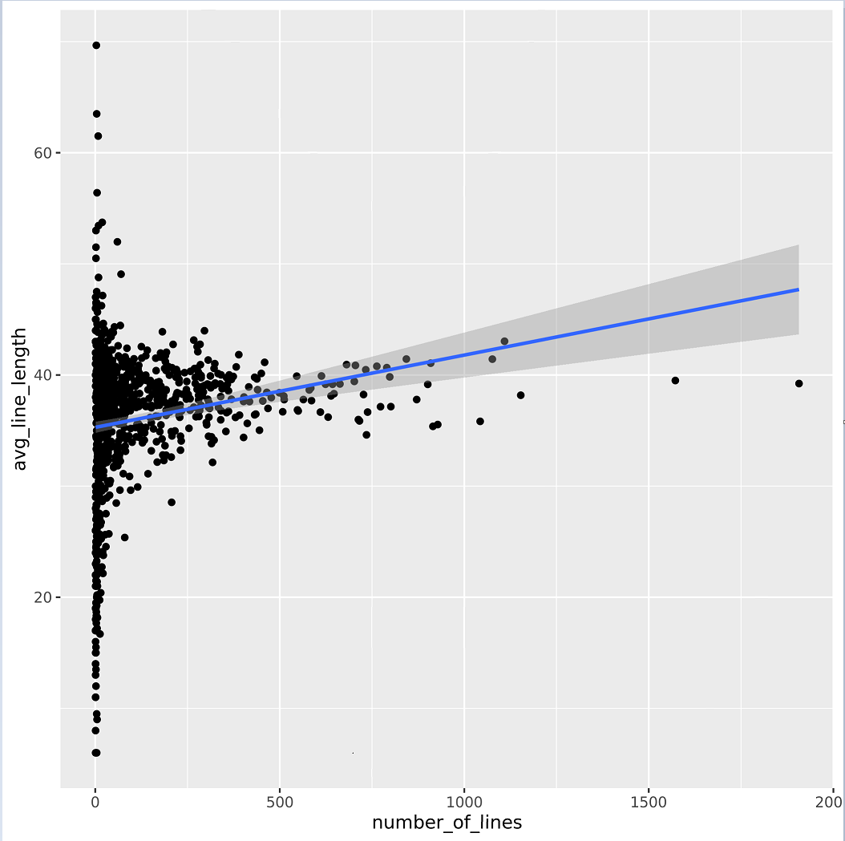
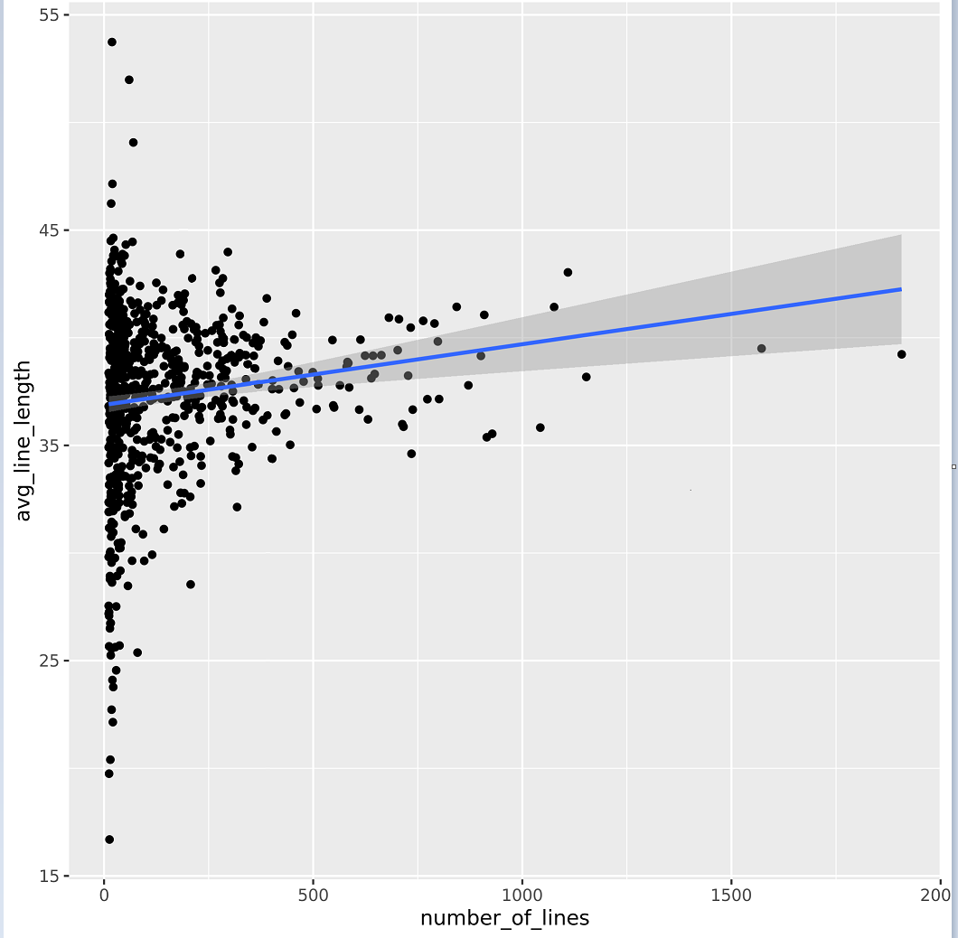
Maybe we didn't prove our theory
We can add a trendline ggplot(data = stats, aes(x = number_of_lines, y = avg_line_length)) +
geom_point(mapping = aes(x = number_of_lines,
y = avg_line_length) ) +
geom_smooth(method = "lm")
{ "$match" : { "number_of_lines" : { "$gt" : 10 } } }
We can add another $match (as a having) and filter out characters with less than 10 lines.
Doesn't seem to show anything

Slide 82
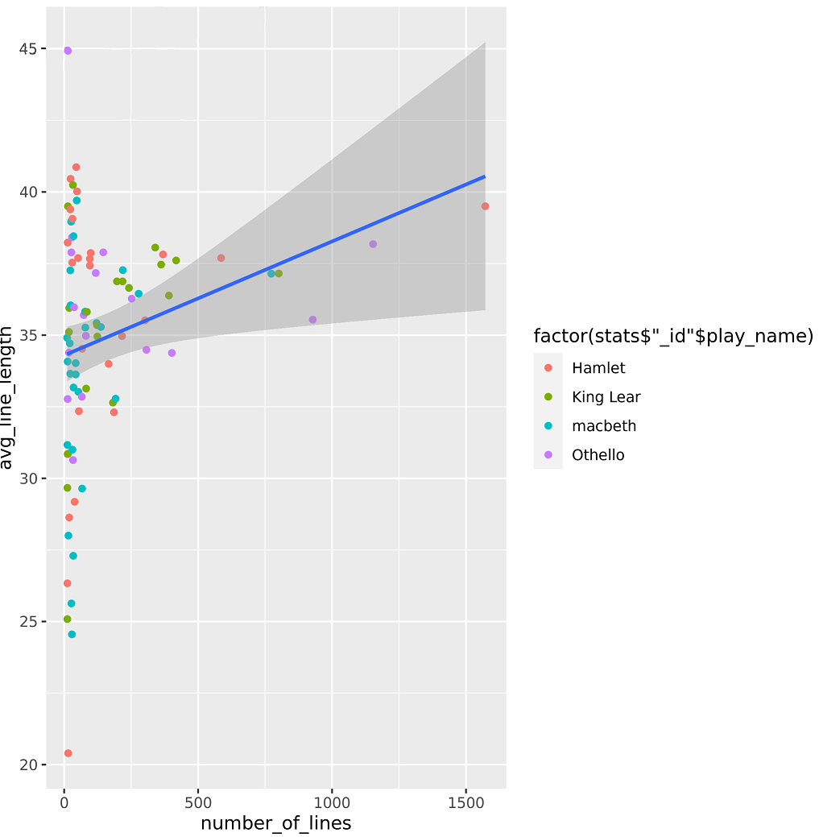
{ "$group" : {
"_id" : {"play_name" : "$play_name",
"speaker" : "$speaker" },
"avg_line_length" : { "$avg" : "$length" },
"number_of_lines" : { "$sum" : 1 }
}
}
#1
Quite a challenge to produce this graph
Mongo: had to group by multiple fields. That is, the _id is not a single field, but a document.
ggplot: special syntax needed to recognize the subatribute _id.play_name Note some syntactic sugar in the ggplot syntax
ggplot(stats, aes(x = number_of_lines, y = avg_line_length) ) +
geom_point(aes(color = factor(stats$'_id'$play_name) ) ) +
geom_smooth(method = "lm")
#2

Slide 83

Mongo and R: Perfect together
Objectivity Alert: Incomimg Marketing Material
Why MongoDB?
Why R?
Community and Ecosystem
Speed
Innovation
The most popular NoSQL database
Over 20 million downloads and 3500 customers
Flexible schema to capture ALL data
More / new / changing data types
Open source
Extreme developer productivity
Analytics against live operational systems
Advanced capabilities beyond key/value pairs
Many industries and use cases
Language and Platform
Community
Ecosystem
The most popular data science environment
Wide variety of statistical and graphical techniques
Open source / highly extensible
2 million users
Taught in most universities
Thriving user groups world wide
Over 10,000 contributed packages
Rich application and platform integration
Domains such as Finance, Genetics, Social Sciences, Geospatial

Slide 84
Mongo's Aggregation Framework Makes this Analysis Possible
$match $group $sort $limit
$lookup
$meta
$geoNear
$geoNear
Consider a collection places that has a 2dsphere index. The following aggregation finds at most 5 unique documents with a location at most 2 units from the center [ -73.99279 , 40.719296 ] and have type equal to public:
db.places.aggregate([
{
$geoNear: {
near: { type: "Point", coordinates: [ -73.99279 , 40.719296 ] },
distanceField: "dist.calculated",
maxDistance: 2,
query: { type: "public" },
includeLocs: "dist.location",
num: 5,
spherical: true
}
}
])
Aggregation
Left Outer Join
{
"_id" : 8,
"name" : "Sara D. Roosevelt Park",
"type" : "public",
"location" : {
"type" : "Point",
"coordinates" : [ -73.9928, 40.7193 ]
},
"dist" : {
"calculated" : 0.9539931676365992,
"location" : {
"type" : "Point",
"coordinates" : [ -73.9928, 40.7193 ]
}
}
}
Geospatial
Text Search and Collation

Slide 85
Mongo's Aggregation Framework Makes this Analysis Possible
$match $group $sort $limit
$lookup
$meta
$geoNear
{ $meta: "textScore" }
Returns the score associated with the corresponding $text query for each matching document. The text score signifies how well the document matched the search term or terms. If not used in conjunction with a $text query, returns a score of 0.
db.email.createIndex(
{ text: "text",
subject: "text" },
{ name: "emailTextFields" }
)
db.email.find(
{ $text: { $search: "accused"} },
{ score: { $meta: "textScore" } }
).sort( { score: { $meta: "textScore" } } ).limit(2).pretty()
Aggregation
Left Outer Join
Geospatial
Text Search and Collation

Slide 86
db.email.find( { $text: { $search: "accused"} }, { score: { $meta: "textScore" } } ).sort( { score: { $meta: "textScore" } } ).limit(2).pretty()
From the public database of Enron correspondence. Names have been altered.
1st hit: "text" : "Mr. Laverty, On the 28th, the Lord impressed upon me to begin praying over Enron at Enron. My daily prayers started on that first email but I began yesterday to do what people call \"prayer walking\" and will continue for 16 days. It is based on something I read in 2 Chronicles 29:17 about Hezekiah cleansing the temple. It took a total of 16 days. The Lord impressed me to read Psalms 119 yesterday and Mr. Laverty, the Lord did NOT condemn you in my heart. It was as if He was telling me of His heart towards you. You know how the Bible tells us that the Holy Spirit will convict us of righteousness too. It was like that. You and I know it is His righteousness but isn't it wonderful that God's heart for you is not accusing. That is the enemy. God does not send the people that are holding up signs and railing accusations. He sends people like me. People that He has given a burden for your needs. [. . .] I know you must be very weary. I am praying for the employees to supernaturally be productive. For the Lord to knit their hearts together and to minister forgiveness. Not to accuse. I haven't read any news yet. Remember I don't have TV or read the newspaper. I am sending this to you without being afraid of what I will read on the internet. Great is His faithfulness...... Susan Morris
2nd hit: "text" : "Dear Mr. Keith Laverty This is a request for an investigation, of Company Policies abuse. This is my plea for Help, and Official Complain against my supervisor Betty Collins My name is Arthur Hall Senior Designer at Nepco 055-50-7538 <<Enron Compliance Officer.doc>> I have bean working at NEPCO since 04/24/2000. I had reported Company polices violations, against my self of being subject of a discriminating abusive, insulting, harassing, unfair treatment by my Supervisor Betty Collins. [. . .] At this point the ABUSE continue getting worse and started to effect my health. I have bean working hard at my job as a designer and and helping to train others. I have a good relationship with my fellow workers and we have mutual respect. I bean treated abusively disrespectfully discriminatingly because my Origin, and or my Age and because she just don't like me. She is accusing me not doing my job destroying database. Coming up with all kind of an accusation trying to say that I can not do my job. I had try to swallow the insult and consult harassment from here, since I like my job and what I am doing but I cant take any more. [. . .]

Slide 87
…but Elasticsearch!
Has much better textual analysis tools.

Slide 88
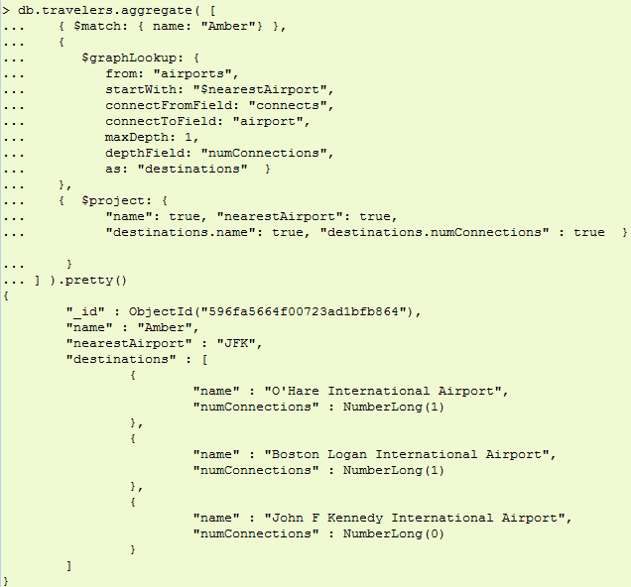
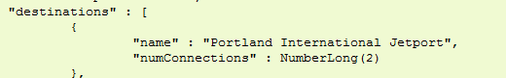
Mongo's Aggregation Framework
$graphLookup
$facet $bucket
$geoNear
Graph Processing
Faceted Navigation
Map Reduce
Amber lives near JFK. If she is willing to make only 1 connection (maxDepth: 1), she can get to O'Hare and Logan
If willing to make only 2 connections, she can also get to Portland

Slide 89
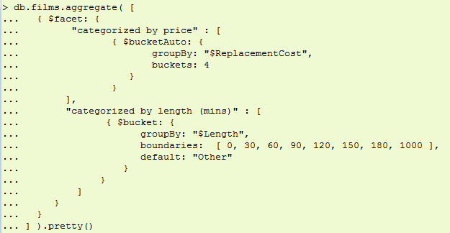
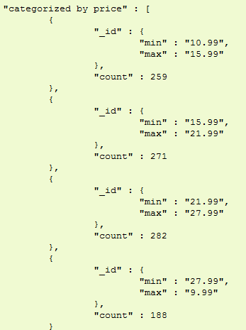
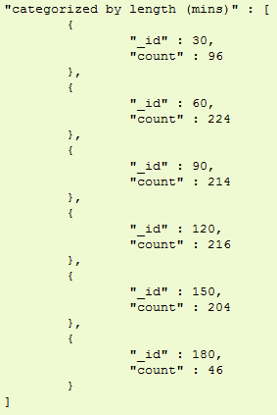
Mongo's Aggregation Framework
$graphLookup
$facet $bucket
$geoNear
Graph Processing
Faceted Navigation
Map Reduce
Facets let you group items by predefined or autogenerated buckets.

Slide 90
Interesting Problems that can be Solved with Mongo and R
Churn analysis: Identify and focus on higher value customers, determine what actions typically precede a lost customer or sale, and better understand what factors influence customer spending
Fraud detection Uncover fraud through data analysis of transactions, identify anomalies and red flags of fraud.
Sentiment analysis: Computationally identifying and categorizing opinions expressed in a piece of text, especially in order to determine whether the writer's attitude towards a particular topic, product, etc., is positive, negative, or neutral
Customer segmentation Divide a customer base into groups of individuals that are similar in specific ways relevant to marketing, such as age, gender, interests and spending
Predictive failure and maintenance Pro-active, real-time monitoring of sensor data and combining it with all other external data sources—structured, unstructured, and semistructured—enables you to predict possible equipment failures
Drug discovery via mining genomes
Geospatial analysis

Slide 91
Use Case #1: Genomic Data Mining

Slide 92
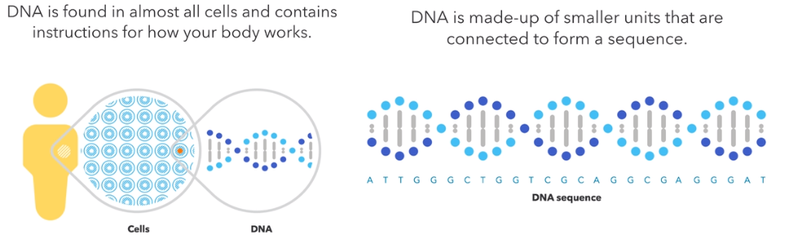
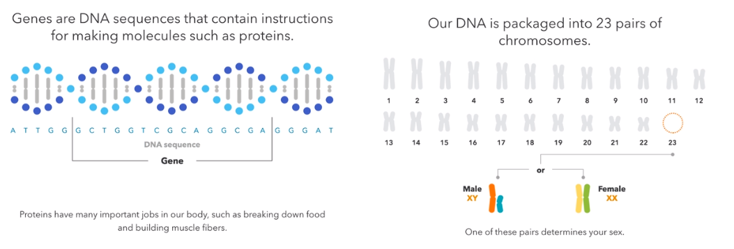
Genomic data
Variations in DNA determine what we look like, what diseases we are susceptible to, etc.

Slide 93

A relevant data set: HapMap3 (1)
Single nucleotide polymorphisms (SNPs) underlie differences in our susceptibility to a wide range of diseases (e.g., Alzheimer's, sickle-cell anemia, breast cancer, prostate cancer, etc.)
HapMap3: data set of 1.6 million SNPs from over 1115 DNA samples
Analysis done in R Studio https://www.rstudio.com/
MongoDB syntax
R syntax

Slide 94

A relevant data set: HapMap3 (2)
Spike around Chromosone 5 is interesting.
Can we retrieve database info for the individual points.
Everything done in R studio, but all MongoDB functionality is available
MongoDB syntax
R syntax

Slide 95
{ "CHR" : 5, "BP" : 29950601, "P" : 9.86401e-9, "SNP" : "rs2972799", "25CORE" : 5.7331, "EFFECTSIZE" : -0.5253, "ASSOCIATED_MOLECULE" : { "identifier" : "AKB98570", "type" : "mRNA" }, "DISTANCE" : 742380, "ORGANISM" : "Homo Sapien", "MOLECULE_TYPE" : "GENOMIC", "VALIDATION_STATUS" : [1,2,5,6], "VARIATION_CLASS" : "SNV", "refSNP_ALLELES" : "A/C", "ANCESTRAL_ALLELE" : "A", "CLINICAL" : ["Prostate Cancer", "Breast Cancer", "Parkinson's Disease", "Type II Diabetes", "Ischemic Stroke", "Autoimmune Disease", "Systolic Blood Pressure", "Body Mass Index", "Adult Height", "Birth Weight", "Rheumatoid Arthitis", "Nephropathy", "Asthma" ], "MAP" : { "PREVIOUS_GENE" : "PGBD3P2", "NEXT_GENE" : "HPRTP2", "POPULATION_SAMPLES" : [ {"NAME" : "ACB", "T" : 0.8438, "G" : 0.1563}, {"NAME" : "ASW", "T" : 0.8033, "G" : 0.1967}, {"NAME" : "BEB", "T" : 0.5988, "G" : 0.4012}, {"NAME" : "CEU", "T" : 0.7677, "G" : 0.2323}, {"NAME" : "CHB", "T" : 0.6602, "G" : 0.3398}, {"NAME" : "CHS", "T" : 0.6810, "G" : 0.3190} ] }, "SEQUENCE" : { "allelePos" : 9755, "totalLen" : 10281, "taxid" : 9606, "snpClass" : 1, "alleles" : "A/C", "mol" : "Genoic", "build" : 150, "seq" : "AATACTGATT ATGGGAAACC CTCTGAAAGT ATATAAACAA GGGTTCTCAA CCTGGCTACA ATGGTTGAGT CATCCTTCTG GAAGGTTTTA TGGTGTCATA GCAGAATTCT AAAACACATG TATGAATAAC TTTAGAAAAG TTAAGCACTC CCTCCTACTG AGAGTCACCA ..." } }
INT LONG
DECIMAL
Goal: Bring all this data together for further analysis
STRING
ARRAY
Fields can contain an array of sub-documents

Slide 96
Aggregation Framework Allows Queries across Collections
{HapMap}
EMBED: SNP, annotations, populations, p-values, effective size, phenotype, study
$lookup: genes, mRNA, clinical conditions
$graphlookup: gene & disease associations
$bucket/$facet: clinical conditions, phenotypes
$textsearch: scientific articles
$geoNear: populations, epidemiology
$mapreduce: depth of coverage, Bayesian estimation, etc.
You still need to think about schema design. There could be other information that you will want to look up.
{Sequence}
{My DNA}
{HapMap}
{Clinical Conditions}
{Gene}
{Scientific Study}

Slide 97
Use Case #2: Vehicular Situation Awareness
https://www.bearingpoint.com/en/our-success/thought-leadership/situational-awareness-and-the-city-of-chicago/

Slide 98

Many Data Sources
For self driving cars, transportation networks…
New data sources could appear at any time. Who wants to have a constantly changing relational DB model?

Slide 99

Mapping data into a Data Frame
Note Mongo Compass!
Data frame using the MongoLite connector

Slide 100

Data Points in a Geospatial Radius

Slide 101

Converting to a Density Map
Around the theatre, lots of traffic

Slide 102

Other Applications
Chicago Airport
Hyatt Regency

Slide 103

{ "_id" : ObjectID("569d651fa3db5f13184a291f"), "TRIP" : 56, "PASSENGER" : "JANE UYVOVA", "TIMESTAMP" : ISODate("2017-06-19T15:32:002"), "ORIGIN_NAME" : "O'Hare International Airport", "ORIGIN_ADDRESS" : "10000 W O'Hare Ave, Chicago, IL 60666", "ORIGIN_GEO" : { "type" : "Point", "coordinates" : [-87.90733214, 41.9741625] },
"DESTINATION_NAME" : "Hyatt Regency Chicago", "DESTINATION_GEO" : { "type" : "Point", "coordinates" : [-87.6247097, 41.887667] }, "POSSIBLE_ROUTES" [ {"NAME" : "route1", "TYPE" : "fastest", "DIRECTIONS" : [...]}, {"NAME" : "route1", "TYPE" : "shortest", "DIRECTIONS" : [...]}, {"NAME" : "route1", "TYPE" : "alternative", "DIRECTIONS" : [...]}, ], "CHOSEN_ROUTE" : "fastest", "ALERTS" : [ { "id" :ObjectID("591e5814aeb86aeeab55e185")" "application" : "469196349", "direction" : "5", "suffix" : "AVE", "applicationdescription" : "DOT Special Event Permit", "applicationnumber" : "DOT409967", "streetnumberto" : "6159", "workdescription" : "Block Party", "location" : { "type" : "Point", "coordinates" : [-87.72789156, 41.782147723]
},
"start_date" : ISODate("2017-06-18T00:00:002"), "streetname" : "KEELER", "worktype" : "BlockParty" } ]
"TRAFFIC" : [ObjectID("5579a8cb2375669bc457ec96"), ObjectID("5579a82b2e75669bc457e5f0"), ...], "WEATHER" : [ObjectID("582600220d242031b3d6413b"), ObjectID("5825a49b85375907e65951c0"), ...]
}
TIMESTAMP
GEOPOINT
ARRAY OF SUB-DOCUMENTS
REFERENCE OBJECT IDS

Slide 104
Aggregation Framework Allows Queries across Collections
{MyTrip}
EMBED: routes, service requests, public safety alerts
$lookup: traffic, weather, bus routes, bikeshare
$graphlookup: transportation network
$textsearch: twitter / social media
$geoNear: restaurants, services, alerts
$mapreduce: analyze most efficient routes
You cannot embed all information; you need to rely on lookups.
{Weather}
{Twitter}
{MyTrip}
{Public Safety Alerts}
{Traffic}
{BikeShare}

